Slide 1
HOLIND

Slide 2
About me: Brennan Barber, MBA Sales, Marketing, and Finance background Experience working with entrepreneurs and investors Husband and proud father of a very special little boy

Slide 3
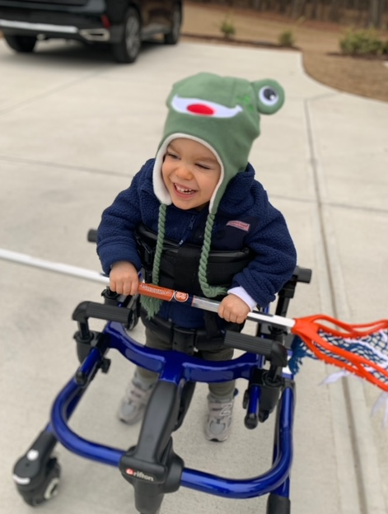

Slide 4
61 Million Adults & 3 Million Children in US Have Disabilities

Slide 5
Patient Cost = ~ $75 - $150 per visit after allotted appointments have been exhausted
*State and Federal assistance programs available, but a challenging process to navigate

Slide 6
Insurance Coverage
Depending on provider, may only cover 60 therapy appointments annually
Coding systems difficult to navigate (Habilitative vs Rehabilitative care)
Insurance companies are looking to minimize their costs for patient coverage
Patient Needs
Chronic Conditions require more that 60 annual visits
Therapy continues at home and patient/families need easier reporting tools
Improving patient care and patient progress improves the patient outcome and minimizes costs

Slide 7
What is HOLIND?
Mobile App that provides incentive to the patient for continuing therapy outside of clinical visits
Apple and Android OS compatibility
Easy to update for therapists and easy to input data for patients
HOLIND eliminates note taking in analogue form and easily stores notes on progress that can be supplied to therapists on a return visit to the clinic
HOLIND improves patient outcomes by keeping the patient/patient families accountable for continued therapy
For non-chronic patients, may reduce clinical setting appointments and savings for Ins. Cos.
A resource for finding available state and federal funding programs

Slide 8
Better patient outcomes Mitigated costs
Clinical Setting Therapy
HOLIND

Slide 9
What I need help with
1
2
Developing Wireframes
Producing MVP
Notes:
Explain how the platform works for students
Students must create an account.
Students are able to browse through classes and filter by various factors
Students select the date and time that fits their schedule best based on availability. They enter their credit card information to pay for class and secure the booking.
Once class is complete, student will be prompted to leave a review for the teacher.

Slide 10
Revenue Model
Sold to Insurance Companies and Healthcare Clinics
Platform provides potential for millions of dollars in savings for reimbursement costs
Pricing TBD through more customer discovery
Patients receive access at no cost
Service provided by insurance company or healthcare provider

Slide 11
THANK YOU!
Brennan Barber
Brennan.Barber@gmail.com
(315)436-0755
Notes:
I really appreciate you coming here tonight. Thank you for your time.

