Slide 1
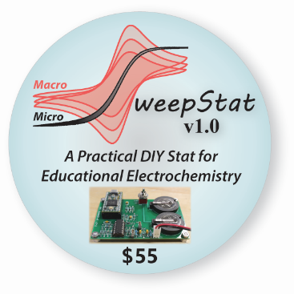
A Universal Platform for Diagnostic Monitoring via Electrochemical Sensors

Slide 2
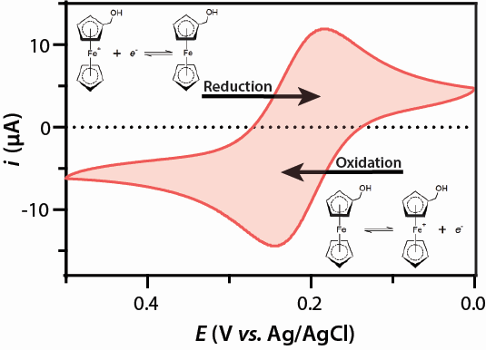
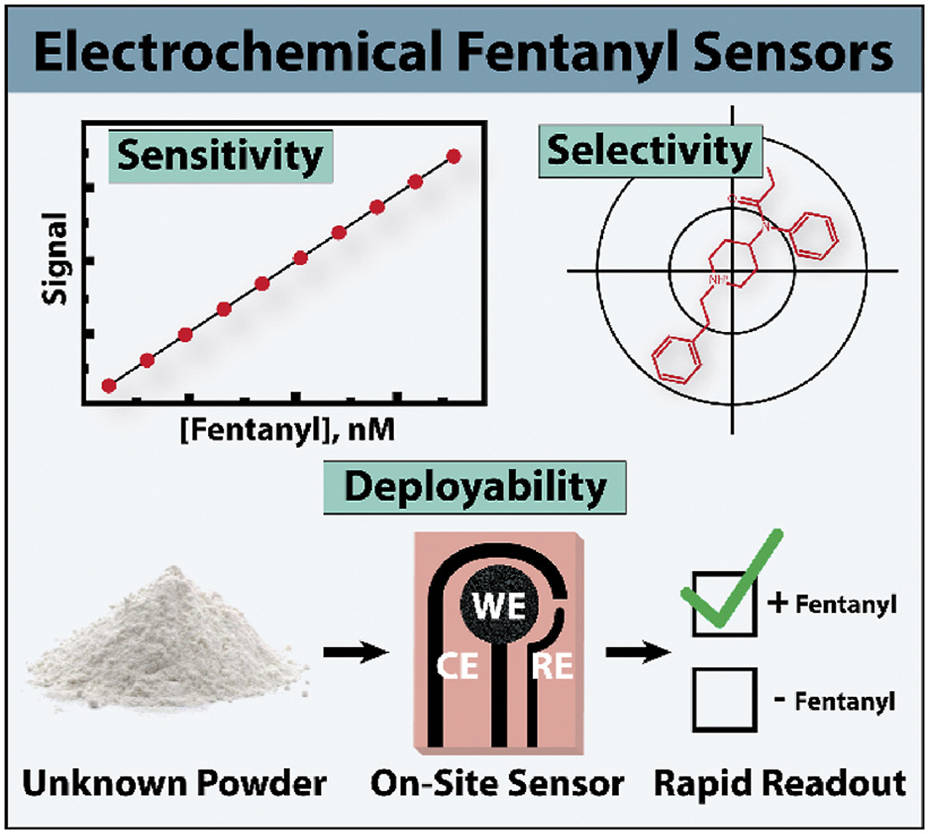
Electrochemistry
Provides highly sensitive measurements
Single atom detection
Robust and reliable framework
Personalize
d medicine
Environmental monitoring
Thought to be expensive ($5k – $10k for laboratory instruments)
Goal: Make electrochemistry available to everyone
Figure 1 – Reaction scheme and cyclic voltammogram for ferrocene methanol oxidation to ferrocenium methanol. Starting point was 0 V vs. Ag/AgCl, plotted in classical convention. Working and counter electrodes were a 1.5 mm glassy carbon disk and glassy carbon rod, respectively. Scan rate was 50 mV/s.

Slide 3
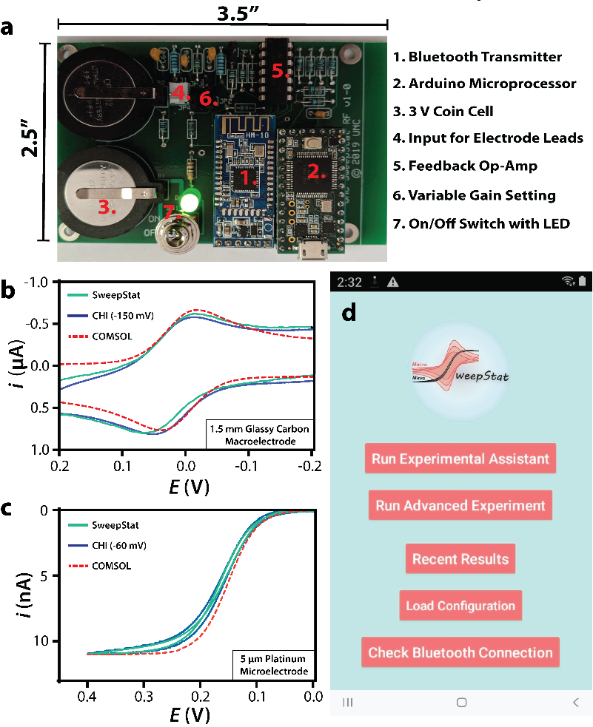
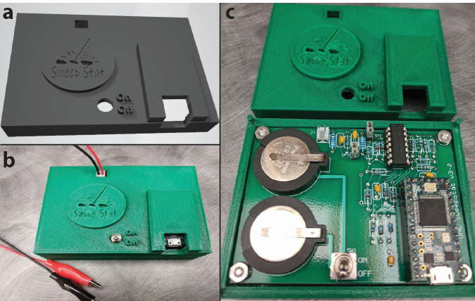
SweepStat
Low-cost (<$50) electrochemistry platform developed at UNC
Figure 4 – (a) Autodesk Fusion 360 3D rendering of customized SweepStat enclosure box. Total print time <10 hours. (b) Printed enclosure containing SweepStat circuitry highlighting two-electrode interface, where the red and black wires correspond to the working and counter electrodes, respectively. (c) Enclosure top removed to reveal internal circuitry.

Slide 4
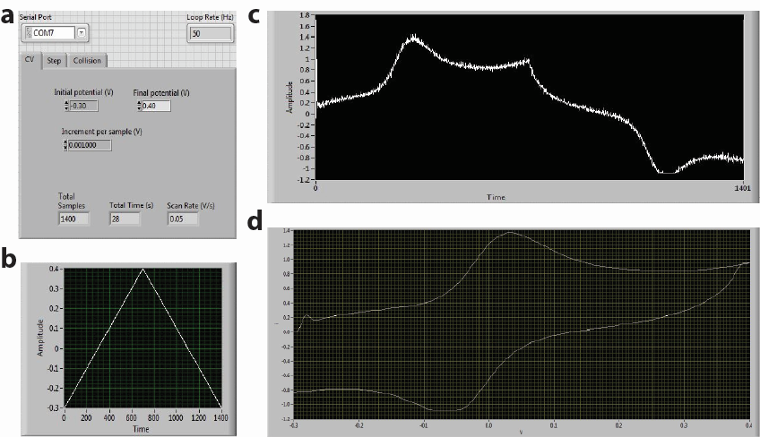
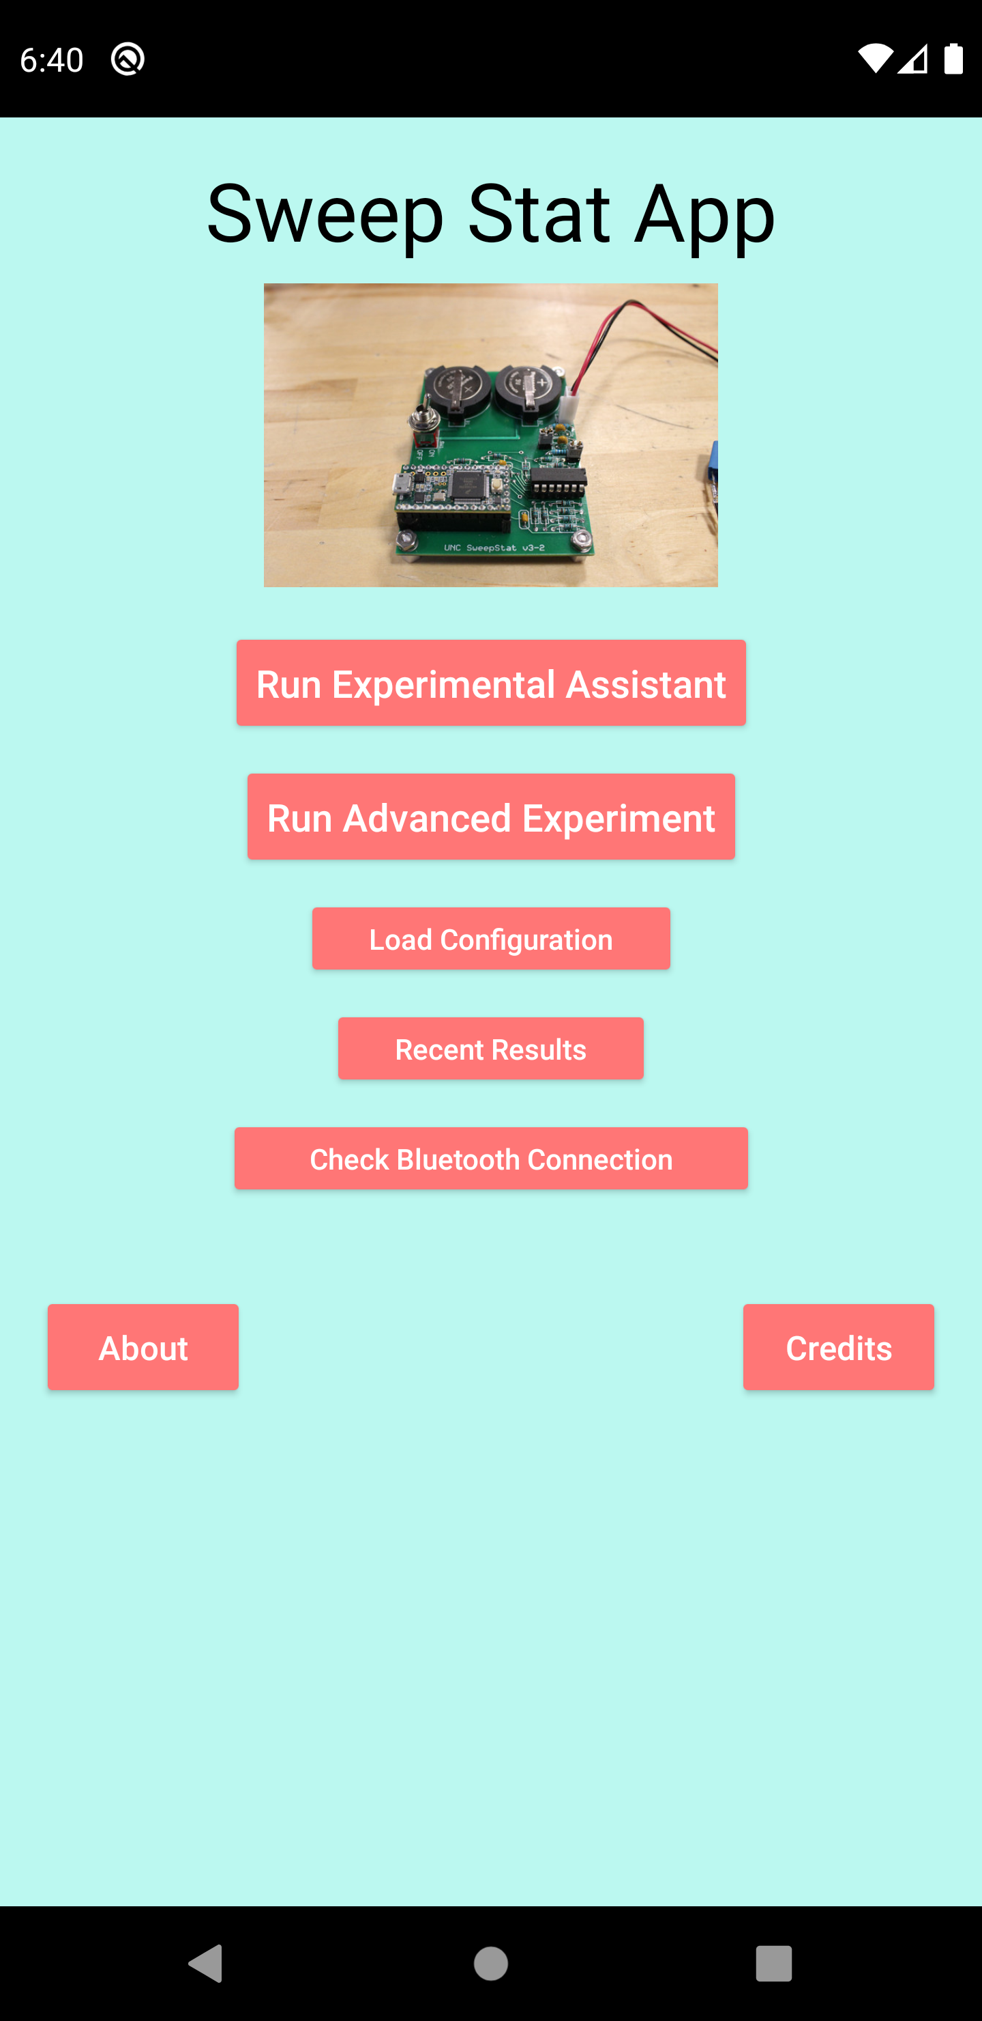
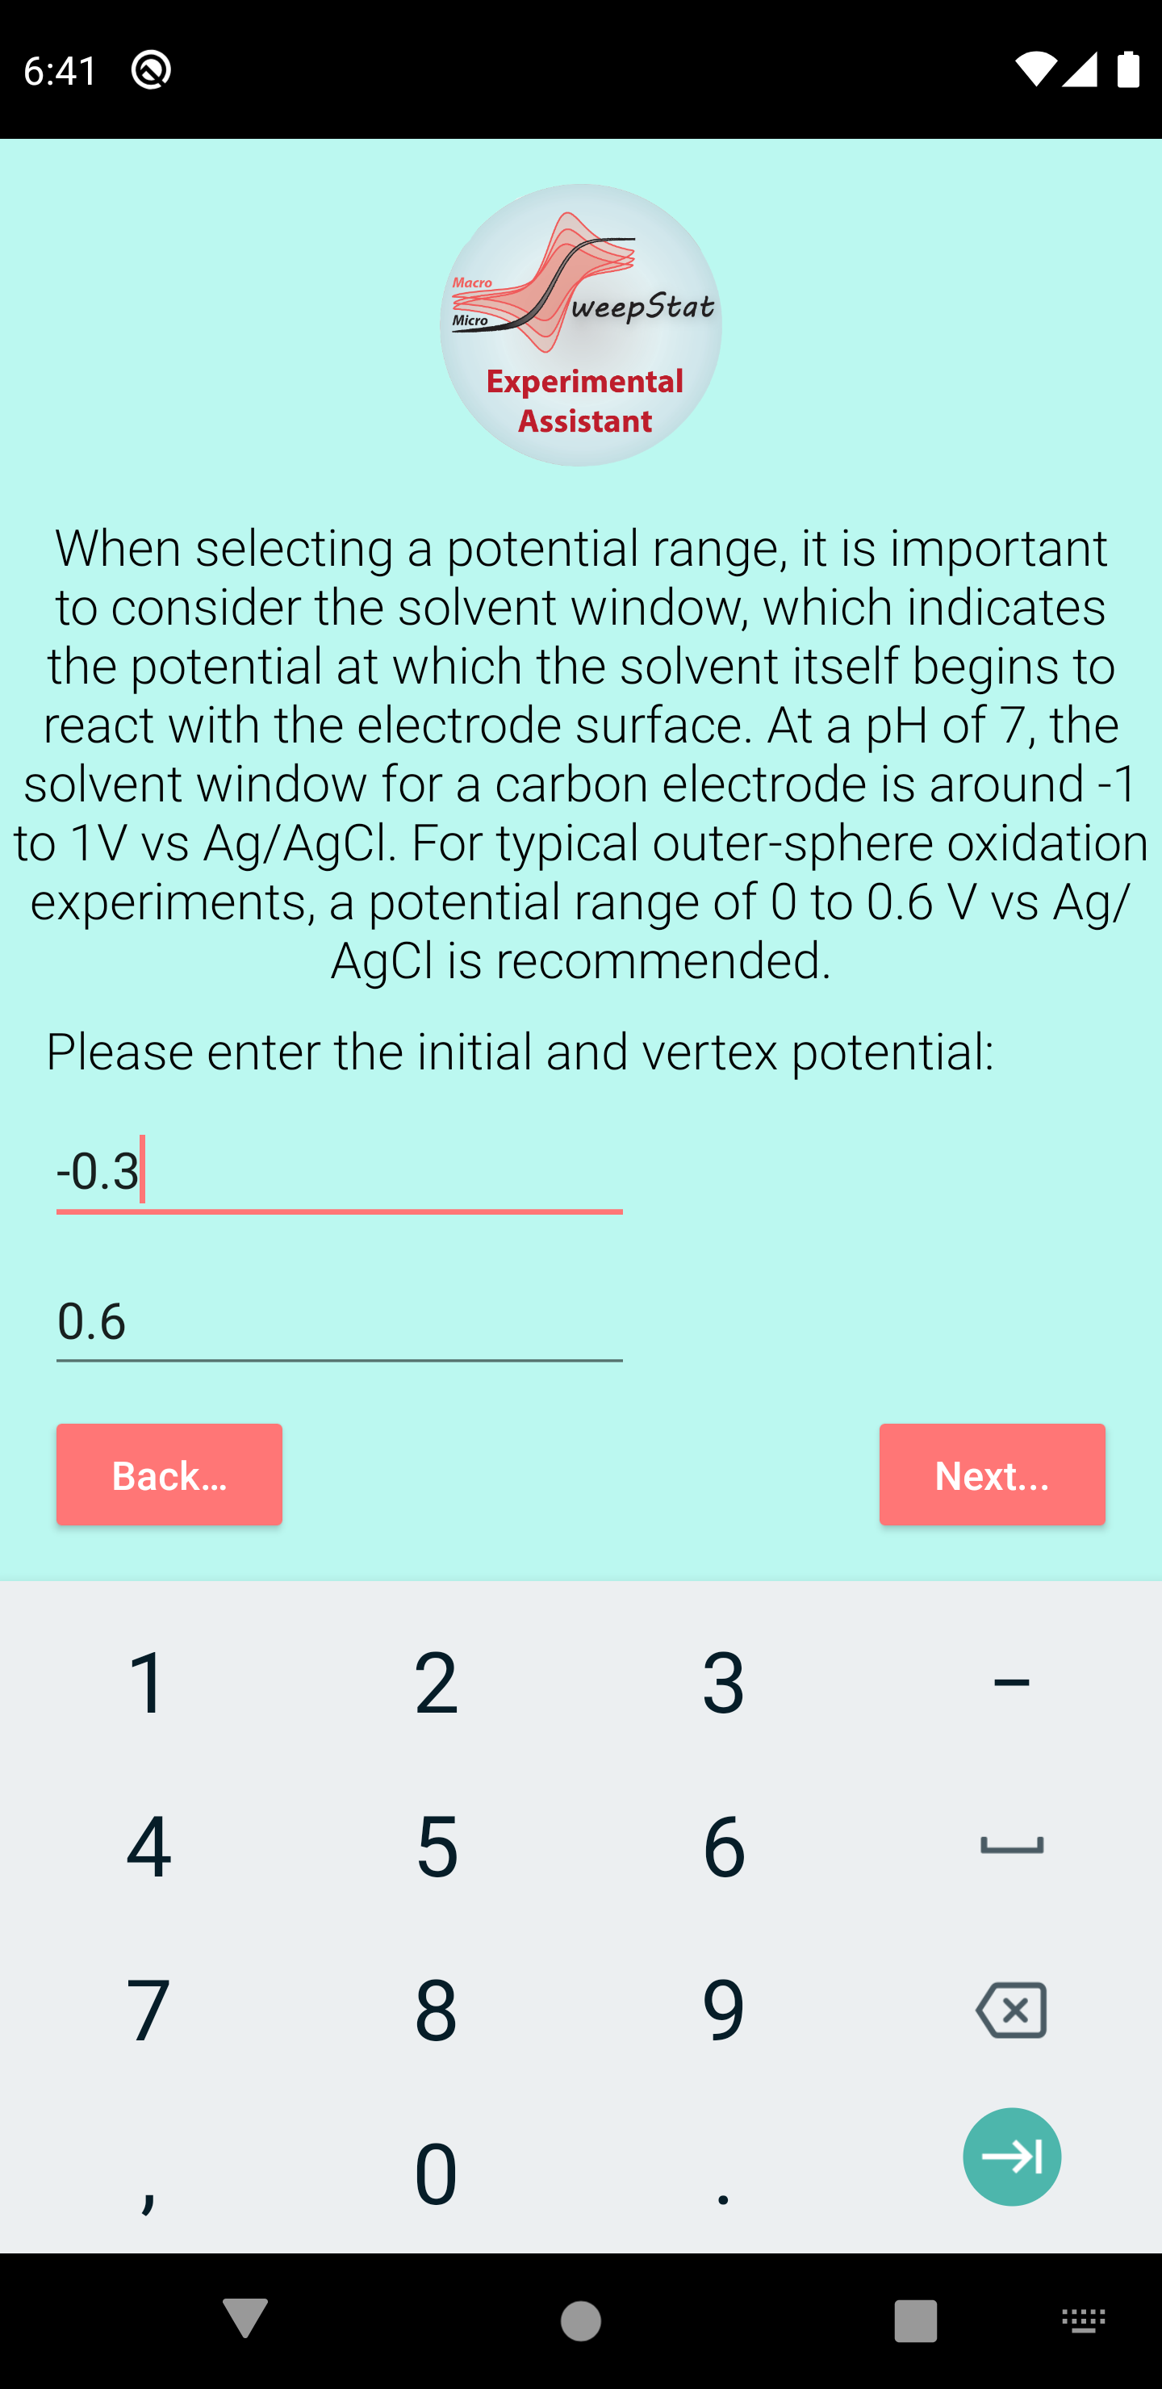
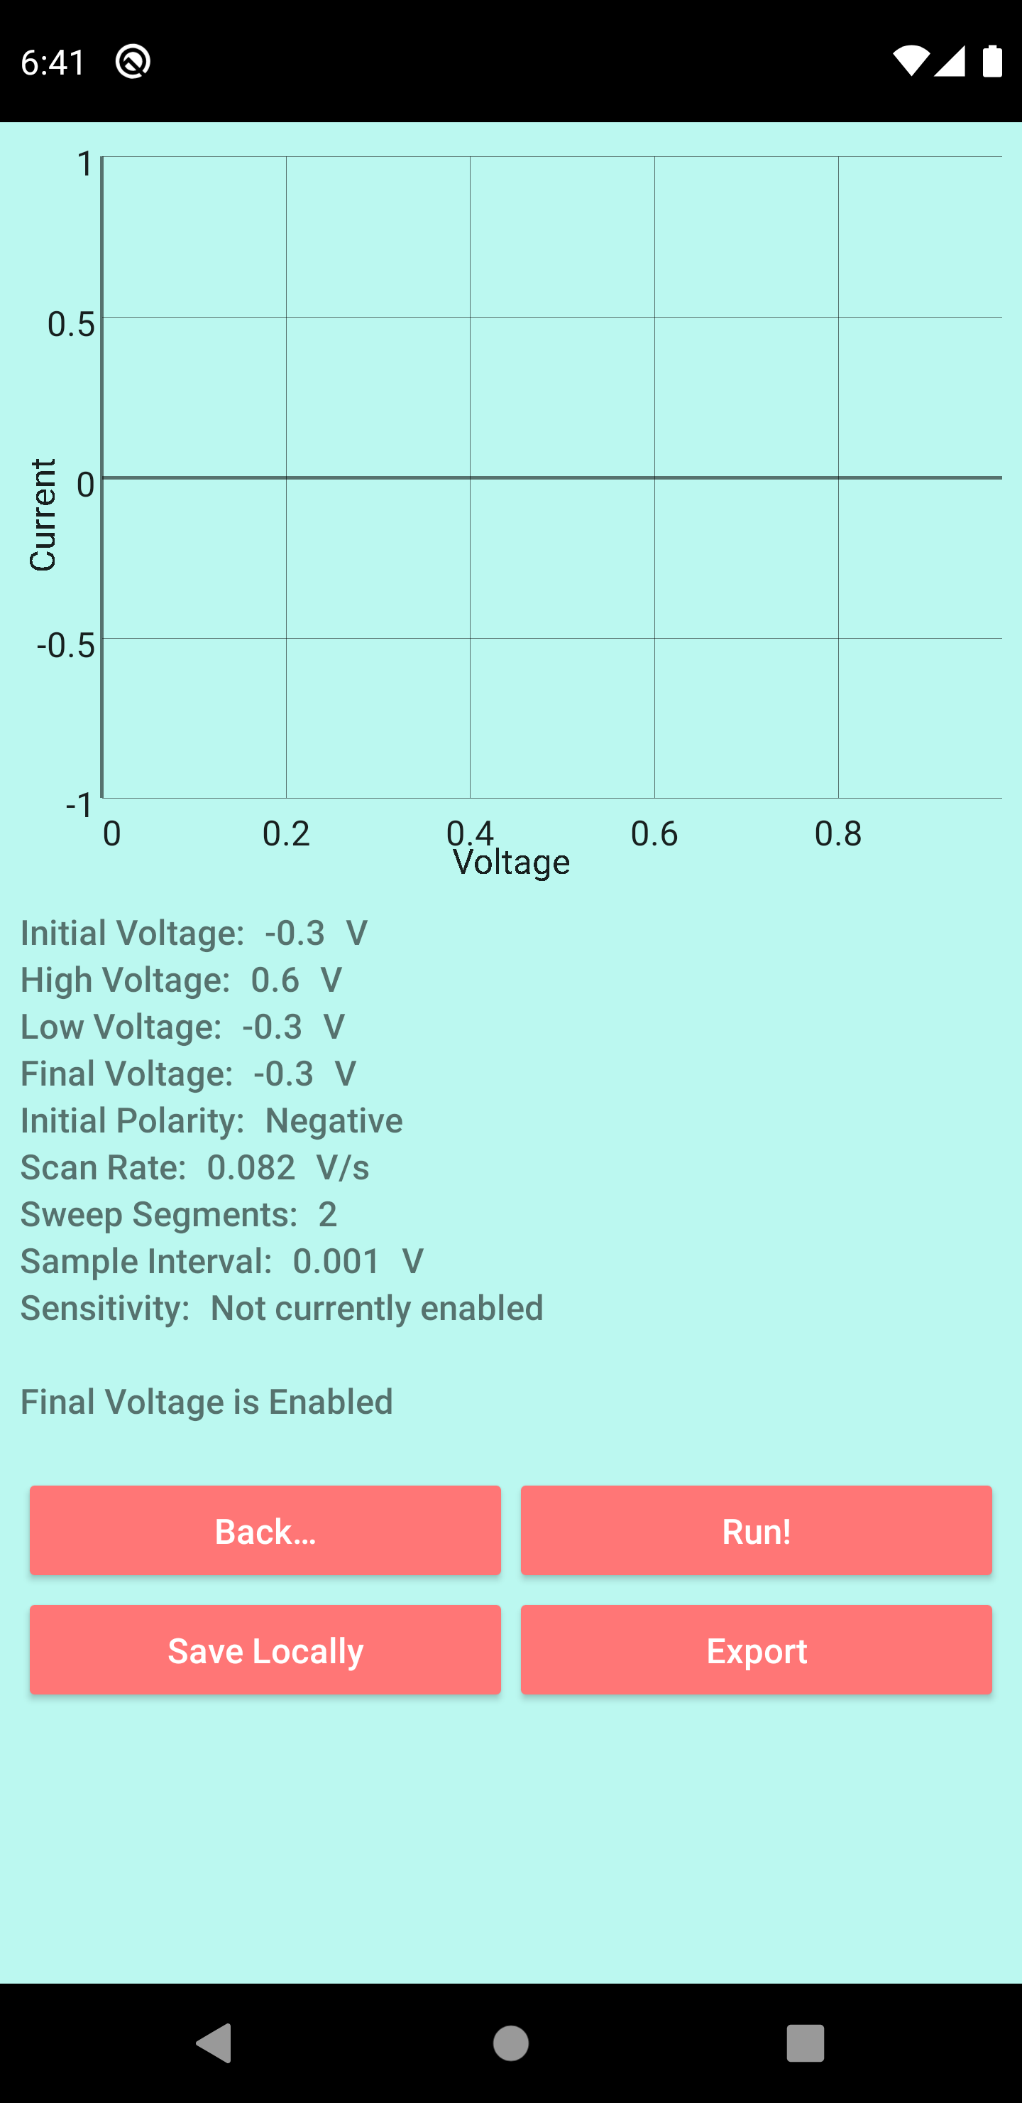
SweepStat App
Current software implemented in LabView
Requires dedicated interface computer
Bulky and expensive, limits wide-spread distribution
Android App developed by last years COMP 523 team
Experimental assistant developed
Real-time data output
Lacks communication protocol with BT
Hooks for additional functionality
Figure 5 – (a) LabView GUI for cyclic voltammetry showing variable experimental parameters. (b) Voltage ramp generated to drive reactions at electrode interface. (c) Raw current output before low-pass filtering and voltage fitting to generate colloquial CV shape. (d) Final voltammogram at a gain setting of 1 μA/V plotted in IUPAC convention by default. Conversion to classical convention was manually applied for data processing.

Slide 5
Our Goals
1. Complete GUI, improved aesthetics
2. Communication with BT and plotting real data in real-time
3. Data processing/automatic analyses (peak identification)
4. Upload to cloud storage
5. Evaluation/remediation of instrumental noise
6. Translation to iOS app for broader audience

Slide 6
SweepStat Advantage: What You’ll Take Away
Opportunity to develop new skills beyond app development
Bluetooth
Hardware interfacing / design of communication protocols
Scientific instrument design
High-impact, high-visibility
Education
DoD agencies (national labs, US Army)
Letters of recommendation
Authorship in peer-reviewed publication when complete
Your app will be used by collaborators in Australia, Hungary, S. Korea, Myanmar, Germany, and Japan!

