Slide 1
Café Table Reservation System

Slide 2
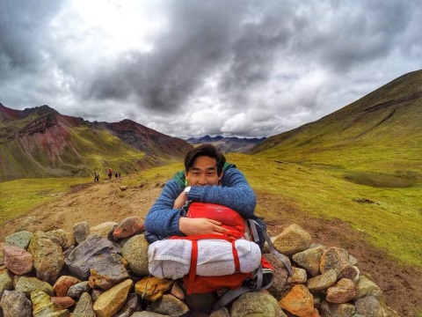
Who are we?
John Lim
Christopher Gsell
PhD Student at UNC
Computer Vision
Hometown: New York, NY
Favorite Local Café: Open Eye
Masters Student at UNC
Software Engineering
Hometown: Houston, TX
Favorite Local Café: Gray Squirrel

Slide 3
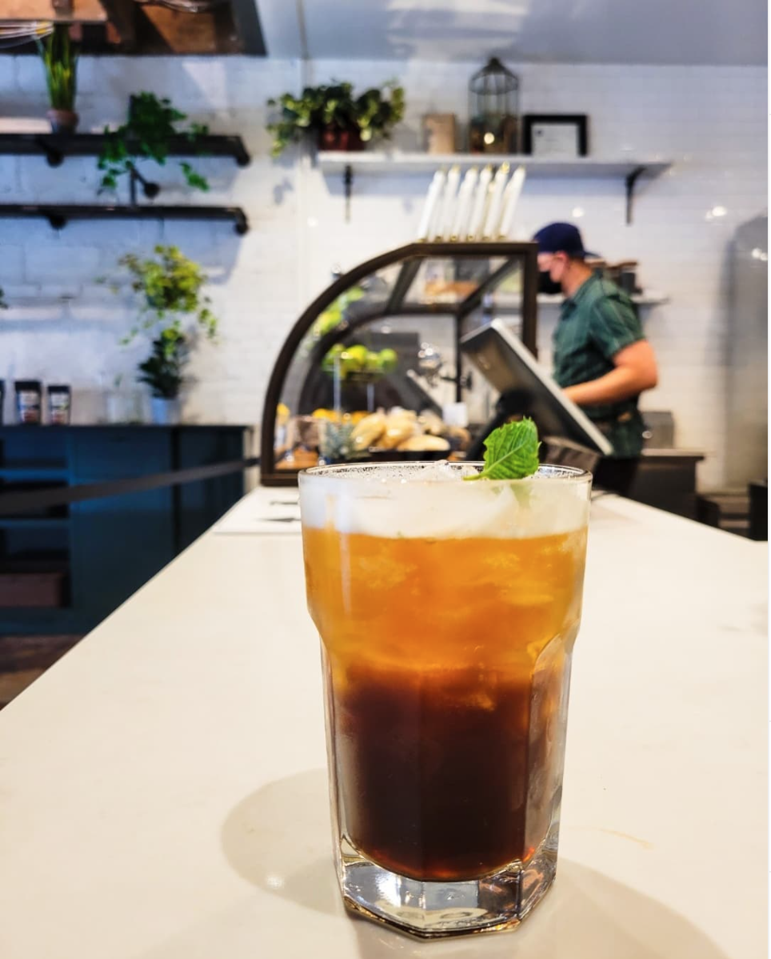
Studying at Cafés in Chapel Hill
Pros:
Lots of Options
Great Place to Work
Contributing to Local Economy
Cons:
Take Up Important Space During Peak Hours
Other Customers Go Elsewhere or Go Home
Lost Revenue for Cafés
Notes:
Great place to work – especially with remote work

Slide 4
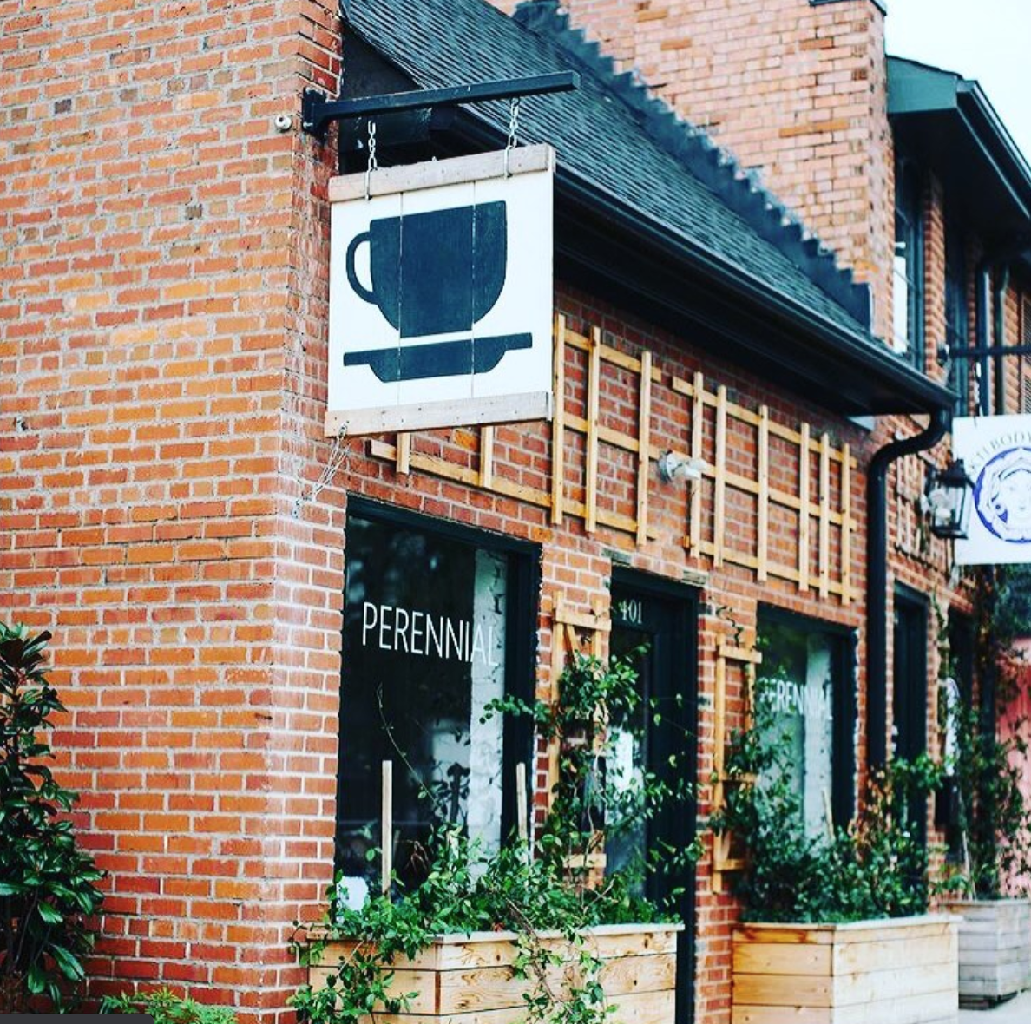
Proposed Solution
Goal: Build an App Allowing Customers to Reserve Tables
Beneficiaries
Cafés:
Generate Revenue For Otherwise Unprofitable Tables
Customers:
Guaranteed Table
App Capabilities:
Cafés List Their Tables and Set Prices
Customers Reserve Tables for Certain Times
Notes:
Set prices: rate totally customizable by café ie can be dynamic based on time of day
It is likely that users will have to pay when reserving so that people just don’t reserve everday for weeks ahead of time
Two faces to app: user side and café side.
Users can see which tables have outlets

Slide 5
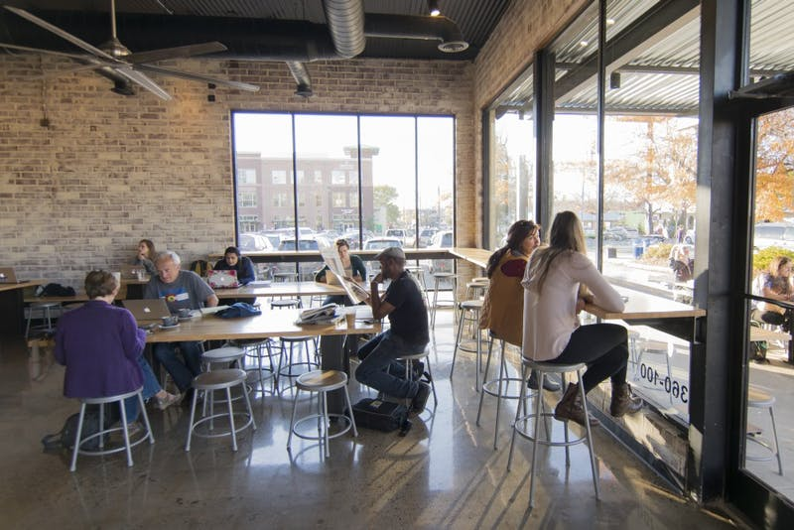
How do you benefit?
Learn Relevant, Marketable Tech Stack
Create Value for Local Chapel Hill Businesses
You Will Be Able to Use Your App
You Will Have Lots of Autonomy w.r.t the Product and Engineering Direction
Notes:
Tech stack great for resume: some ideas we’ve had: Stripe, Firebase, etc

Slide 6
Conclusion
Questions?
Contact Info:
John Lim, jlim13@cs.unc.edu, 631-624-5223
Christopher Gsell, cgsell@cs.unc.edu, 713-213-7178

