Slide 1
XAITK:
The Explainable AI Toolkit
UNC Comp 523 Pitch
Kitware
Brian Hu, brian.hu@kitware.com
Paul Tunison, paul.tunison@kitware.com
Disclaimer: This research was developed with funding from the Defense Advanced Research Projects Agency (DARPA). The views, opinions, and/or findings expressed are those of the author(s) and should not be interpreted as representing the official views or policies of the Department of Defense or the U.S. Government.

Slide 2
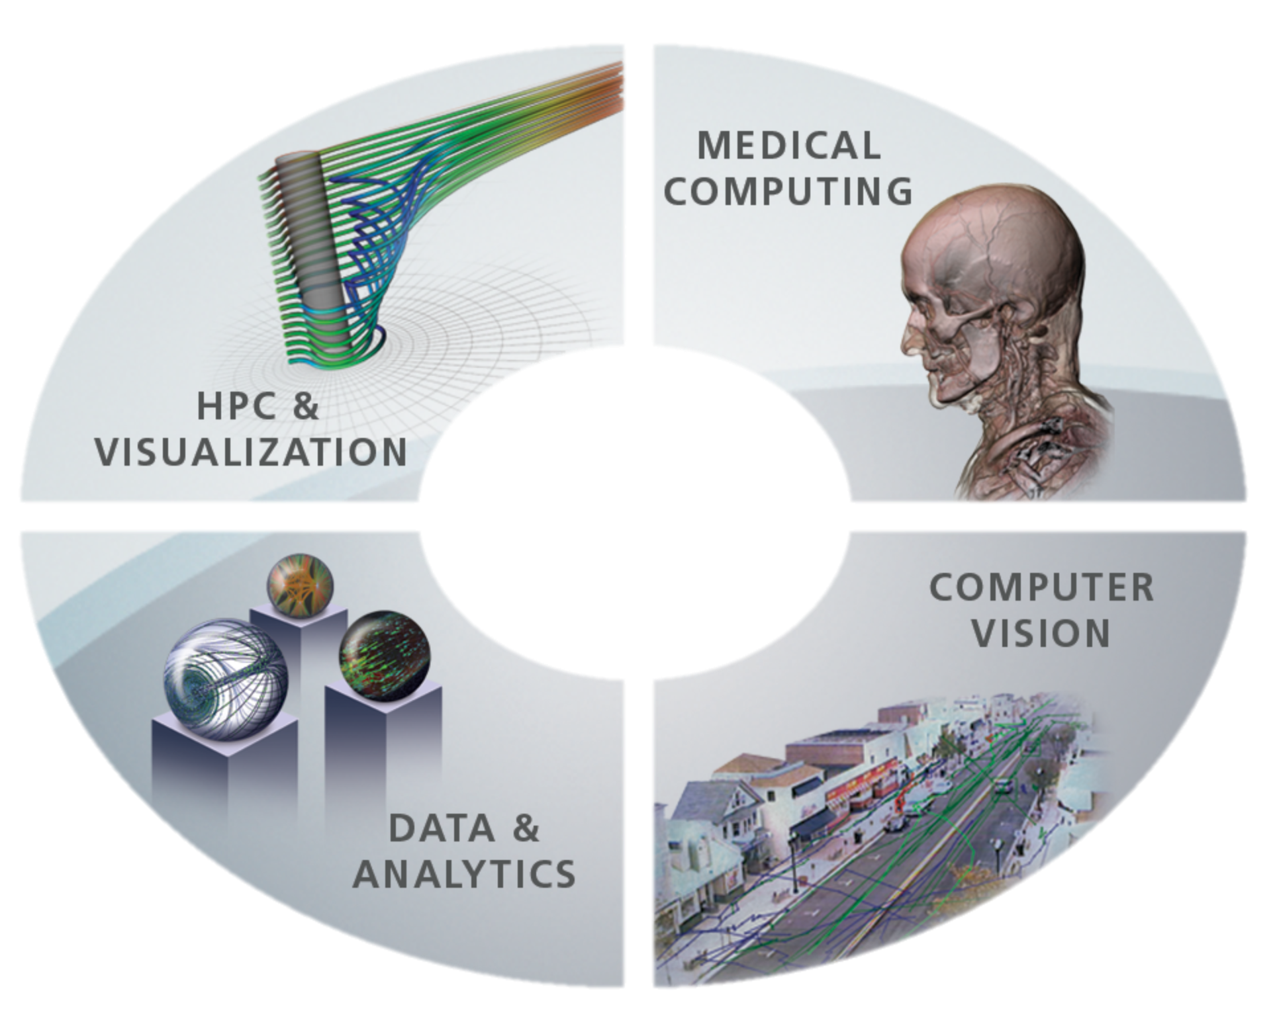
Kitware Company Overview
Open source software R&D: algorithms & applications, image & data analysis, training data, integration, and testing
180 employees: ⅓ PhD, ⅓ masters
Offices: Albany, NY; Chapel Hill, NC; Santa Fe, NM; Arlington, VA, Minneapolis, MN; Lyon, France
Secure facility: Albany, NY; 34 cleared personnel SCI clearances
Kitware.com
ParaView
CMake
Commercial and Government Business Models
Commercial: 11% of Revenue
Efficient commercial contract process
Commercial business models to suit commercial business needs
Government: 89% of Revenue
Efficient government contract process
All government-funded software is provided with unlimited rights to the government
Released as open source when permitted
CDash
Resonant
100% Employee Owned

Slide 3
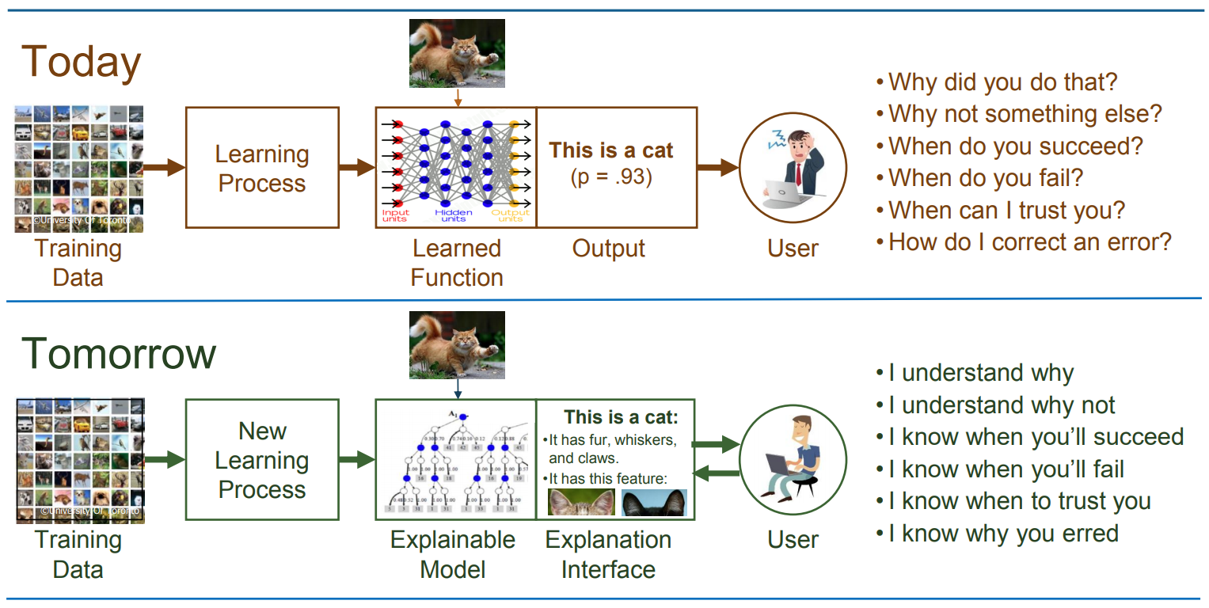
Explainable AI (XAI)
https://www.darpa.mil/program/explainable-artificial-intelligence
Approved for public release; distribution unlimited

Slide 4
Explainable AI (XAI)
https://www.darpa.mil/program/explainable-artificial-intelligence
Approved for public release; distribution unlimited

Slide 5
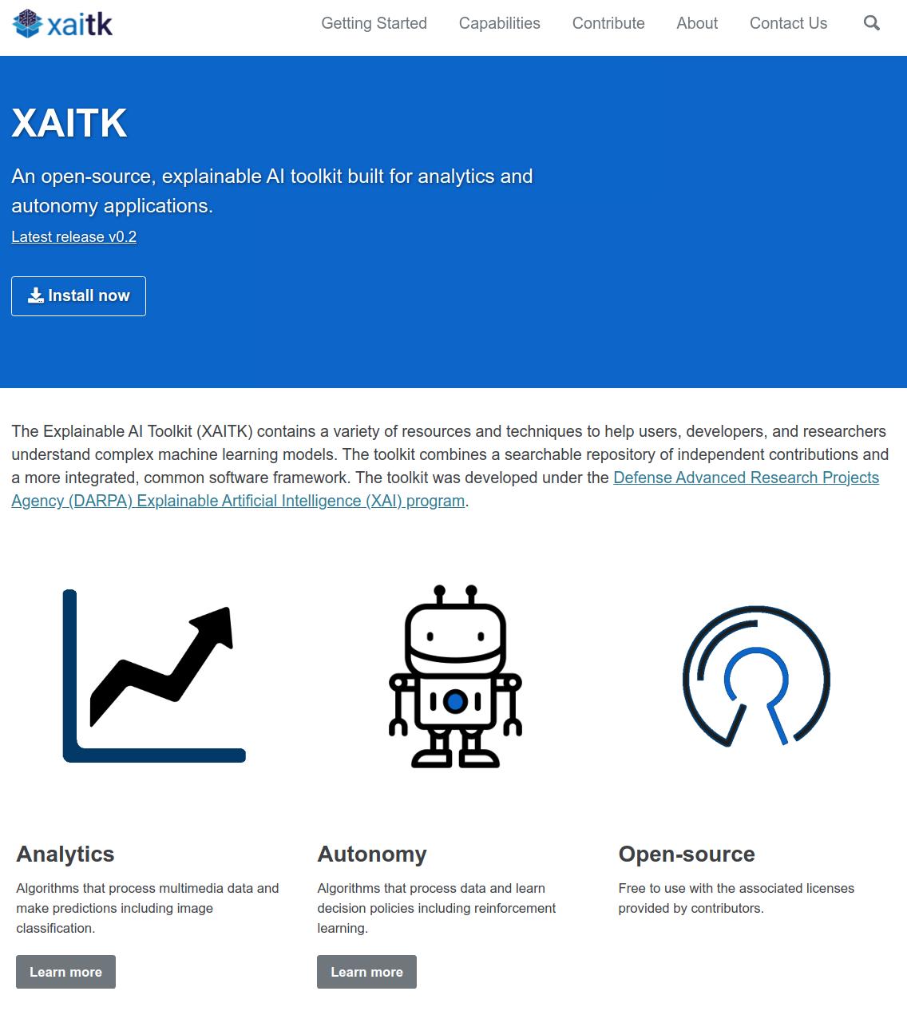
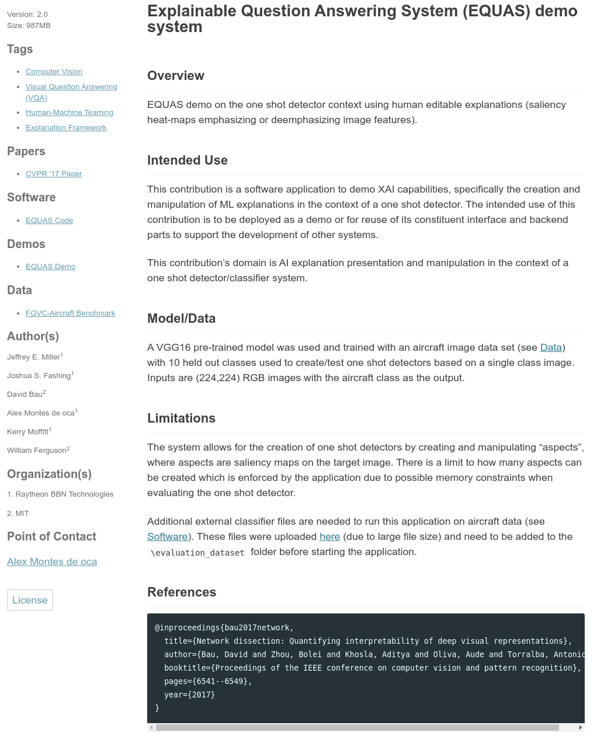
XAITK Website is Live!
Landing Page
Example Contribution
https://xaitk.org

Slide 6
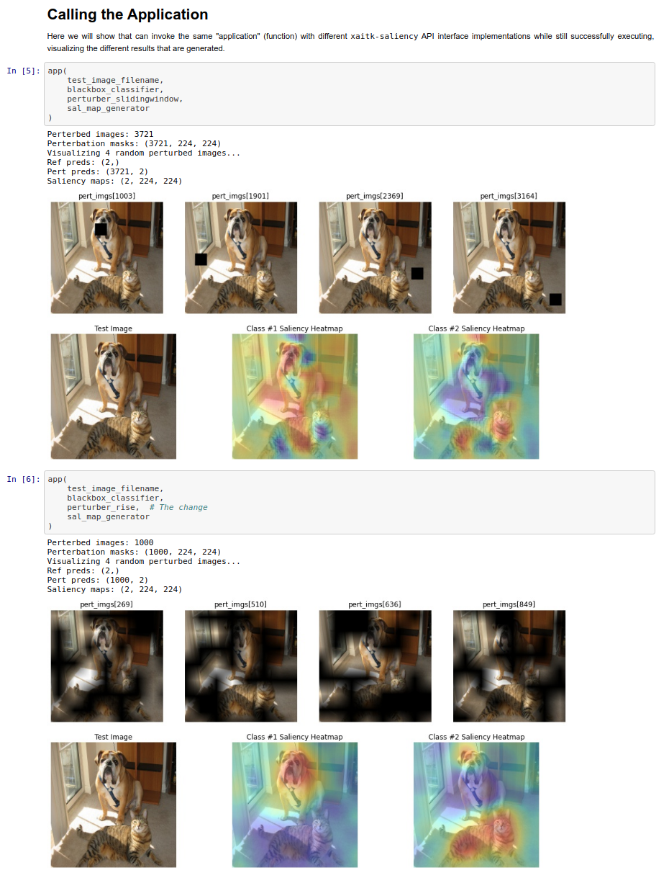
xaitk-saliency package
Support for image classification, similarity, and object detection
Swappable plugin interface that allows for configuration and extension of algorithms
Example Jupyter notebooks to showcase capabilities in a data science workflow
https://github.com/XAITK/xaitk-saliency/tree/master/examples

Slide 7
UNC Comp 523 Pitch
Goal: Develop a containerized web-service to provide a RESTful API for image-based saliency algorithm invocation using the xaitk-saliency package.
Requirements:
Services should be housed in a separate repository from xaitk-saliency, employing modularity between the base library and the “application” that is the web service(s)
Use of established, mature dependencies for major components, like Flask or FastAPI for the server component
Use of Docker or Podman for the containerization of the environment and application

Slide 8
To learn more:
xaitk.org
xaitk@kitware.com

