Slide 1
Easy Access
Opening the door to higher ed.
Vitaly Radsky & Rocky Moon
Notes:
Easy Access builds college search and advising tools that help low-income and first generation students access college.

Slide 2
What we do
College search and advising tools that help low-income and first generation students access college and careers.
Mission
Digital equity tools that provide opportunity for underserved communities.
Notes:
We have a broader, long-term mission to create digital equity tools that increase opportunity for underserved people and communities.

Slide 3
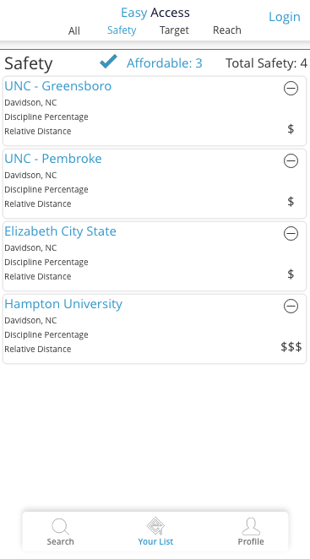
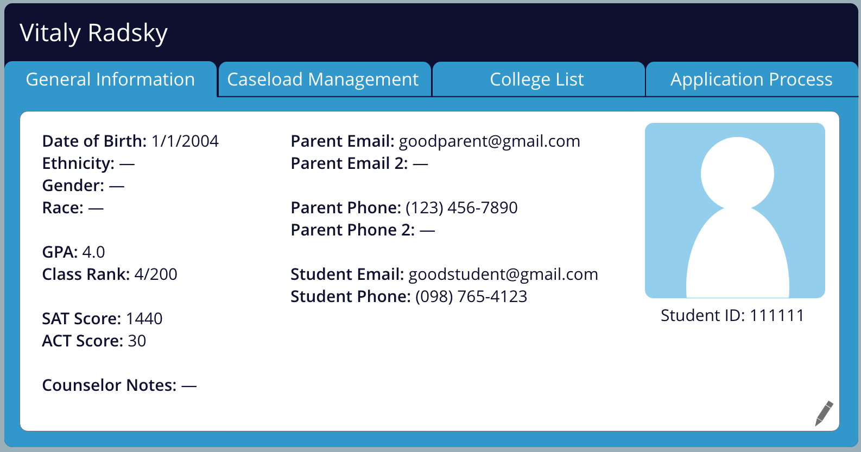
Two Products
that help low-income and first generation students access college.
1. Student App
A college search app for students
2. Counselor Portal
A caseload management system for hs counselors
Notes:
Right now, Easy Access is building 2 products:
First a college search App for students to help any student create a balanced and affordable college list no matter where they live in the U.S.
Second, a caseload/data management portal for high school counselors to manage their caseloads and make sure that no students fall through the cracks in their junior and senior years of high school.
The CS523 team for the Spring 2021 will focus on developing the Counselor Portal.

Slide 4
The Team
Rocky Moon
MEITE Graduate ‘19
College Counselor @ Emily K
Vitaly Radsky
PhD Education Policy ‘24
Former College Adviser @ CAC
15+ years of experience with college advising
Passion for college access & equity!

Slide 5
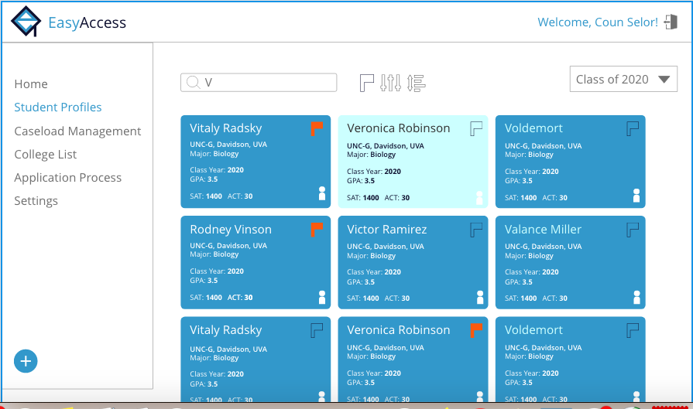
Where We Are Now
Existing Functionalities
-Counselors can create accounts
-Create Multiple Cohorts per counselor
-Uploading & Downloading Data
-Data display, filtering, sorting
-Stripe Integration
-Editing data & creating custom fields
-Connection w/ student app
Give it a try: https://counselors.easyaccess.education/
Notes:
https://easyaccess-9ffaa.firebaseapp.com/
https://counselors.easyaccess.education/
Give it a try: make an account and play around with the existing tool!

Slide 6
Goals for Fall 2021 w/ CS523
1. Integrate “paid” features with Stripe
Multiple counselors can view/edit a cohort
2. Build College Search View
3. Improving existing data upload & download
Notes:
1.Right now we have Stripe integration but everyone can do everything for free. We need to create rules for who can access which features based on their account type.
2.Create a data connection with the student app so that data can be shared with counselor portal & vice versa. Possible creation of messaging feature or integration with Remind
3. Improving existing features (mainly front end): uploading data, editing the Student Profile page.

Slide 7
Technology Architecture
Frontend
The frontend of the app uses a React framework, ag-Grid API, as well as JavaScript, HTML, and CSS. React’s Context is used for state management.
Backend
The app uses Firebase for hosting and Cloud Firestore as the database. Firebase services such as extensions and cloud functions are also used.
Payment Processing API
The API used for payment processing is Stripe.
There will also be documentation from previous teams-- CS523 in Fall 2020 & 2021, & a team from summer 2021.

