Slide 1
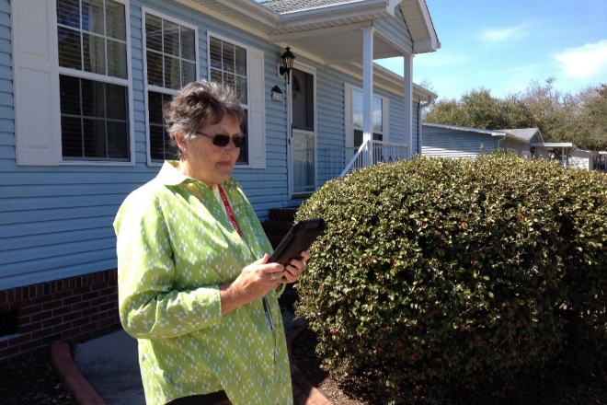
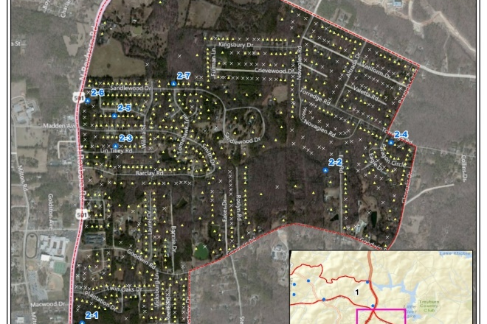
Collect SMART
Survey Management and Response Tools
Matthew C. Simon, MA, GISP

Slide 2
What’s the Need?
Reliable high-quality primary data about communities
Sampling expertise
Affordability
Notes:
Regional and state level data commonly exists but high-quality community level data is hard to find. Community level data is needed to reveal the disparities within a community. Validated community sampling methods are needed to collect this accurate, high quality primary data that doesn’t require extensive expertise in population sampling, geographic information systems and costly software and computer equipment. Many local health departments and community-based organization do not have the resources to collect this type of data and lack sampling expertise – this is where Collect SMART can help.

Slide 3
Overview
Allows for rapid collection of community-level data
Tested in 3500 interviews
503c Hospitals, LHDs, Emergency
Managers
Notes:
Collect SMART allows for the rapid collection of community-level data, improving the timeliness of data collection while reducing the cost of purchasing mapping/data collection software and equipment. The beta version of the app and website have been tested in 3500 interviews in five states. It has been proven to be an efficient and cost-effective solution for obtaining high quality, representative community health data. The software can be used by hospitals, local health departments, emergency managers or any other community-based organization to collect information about the status of their community.
Collect SMART has two parts; the project management website and the mobile app

Slide 4
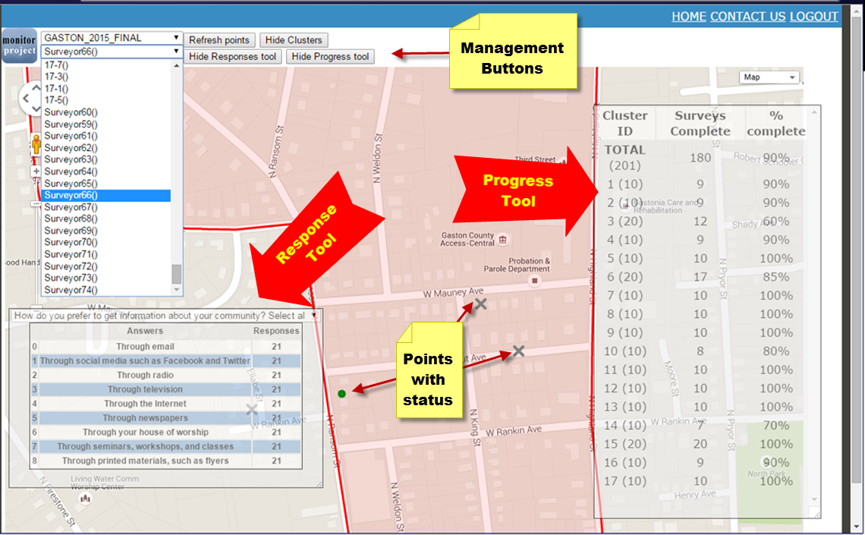
Web Application
U.S. Census sampling
Cluster or simple random
Project dashboard
Create surveys
Notes:
The web application uses the U.S. Census api to determine the population in an area and implement a random sample with probability proportional to size. Once a sample is drawn, the application allows the project manager to push the sample out to the app, directing survey teams to the appropriate address to conduct an interview. The web application then allows a project manager to monitor the progress of surveyors and analyze incoming data from the field. The project dashboards allows the manager to see the number of surveys completed by each team and by sampling unit. A separate desktop application, Epi Info, can be used to design the questionnaire and export an .xml file which can be uploaded through the web application and pushed out to the app.

Slide 5
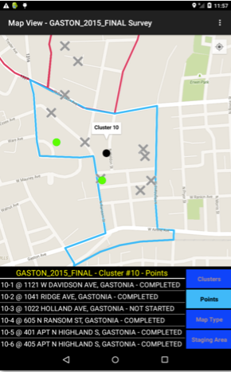
Mobile App
Epi Info integration
Google Maps + user spatial data
Navigation
Collection of responses
Notes:
The mobile app was built on the open-source framework of Epi Info, a free statistical software/platform developed by the CDC. The mobile app adds a mapping module which allows the project manager to upload spatial data, such as census blocks or predetermined survey locations. The mobile app takes questionnaires built in the desktop version of Epi Info, allows users to navigate to the survey locations and collect responses. It is compatible with Android tablets and phones. With electronic devices data can be collected easily and with fewer errors. Along with the features of collecting data, the app will be able to communicate with other teams in the field and the project manager.

Slide 6
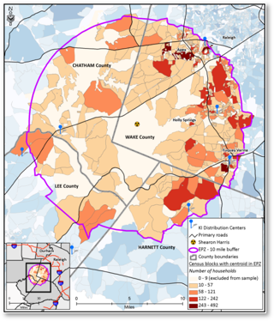
Applications
Community Health Assessments
Pre-/Post- disaster assessments
Any type of field data collection
Outbreak investigations
Opinion surveys
Potassium iodide (KI) survey​
Notes:
Collect SMART has been tested in 3500 interviews and has been proven to be a cost-effective and efficient solution to gather high-quality data about a community. It can be used in a variety data collection efforts such as community health assessments or pre/post disaster assessments.

Slide 7
Collect SMART Benefits and Summary
Survey Management System
High quality data collection and real-time analysis
Automated sample selection
Project Dashboard enhances situational awareness
Mobile app with offline capabilities
Efficient - cost-effective – solution for collecting survey data
Notes:
Collect SMART allows for rapid collection of representative community-level data for decision-makers based on valid sampling methods, improving the timeliness of data collection while reducing the cost of purchasing or maintaining data collection software. Collect SMART includes:
Mobile software app
Project management dashboard website
The mobile app allows teams to navigate to survey sites to conduct interviews and digitally input the data online/offline. The web-based dashboard allows project managers to oversee survey implementation, monitor interviewers in the field, and analyze incoming data.

