Slide 1
BIG
WORDS
Growing the innovators of tomorrow...one word at a time.
Notes:
BLOT:
Billions of dollars are spent to remediate the 'skills gaps' in our education systems. The gaps are preventable through daily read aloud practices. But parents either don't know or are overwhelmed by the demands of modern life. Physicians want parents to read more and hand them paper book logs to fill out. Parents need a tool to help focus caregiving teams on the one thing science shows babies' brains need most: words.
BigWords is a FitBit for words. It provides caregiving teams a communication platform and feedback on the quantity and quality of words babies hear in storybook reading. Additionally, BigWords provides personalized word-based book recommendations to keep the word collections growing. BigWords grows big brains. BigWords is growing the innovators of the future, one word at a time.

Slide 2
Societal Challenge: Skills Gaps
60% of kindergarteners not ready. (USDE, 2015)
74% of freshmen not ready for STEM. (ACT, 2016)
Billions lost in societal ‘brain drain’ and costs of remediation and incarceration.

Slide 3
Evidence-based solution:
The quantity and quality of words in the first 3 years of life predict skills more strongly than socioeconomic status, parent level of education, and race/ethnicity(Head-Zauche, 2017).

Slide 4
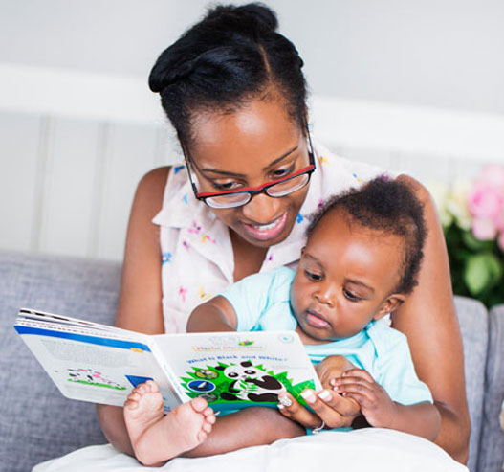
Words Grow Brains:
Storybook reading = quality words
Quality words = novel vocabulary context of love

Slide 5
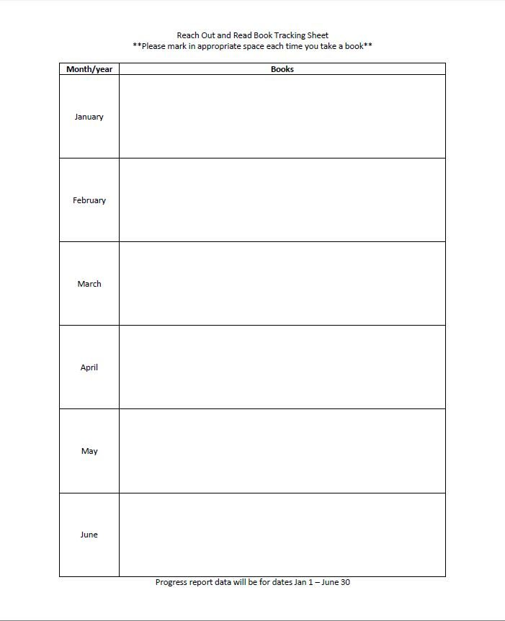
Current Challenges:
30+ years effort
Fewer than 50% of families read aloud. (Child Health, 2019)
Technology lags.
Book tally sheet given by pediatricians.

Slide 6
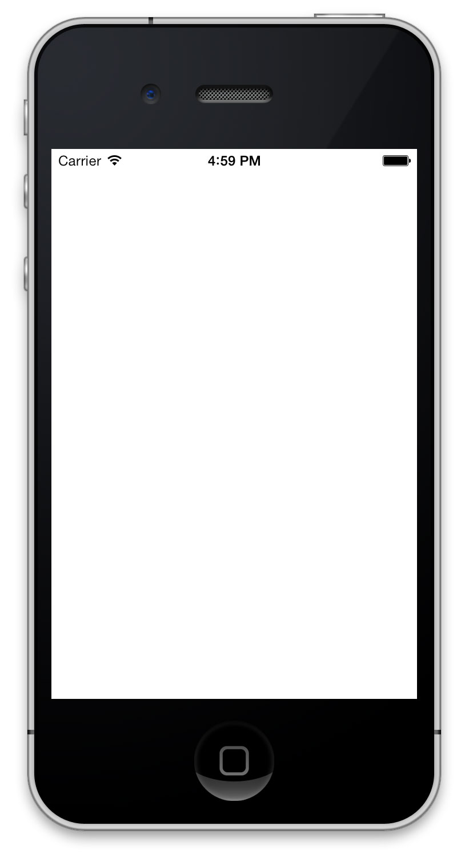
BigWords
*Insert Name Here* Personalized Summary
FitBit for words (+recommendations)
Words per book, week, lifetime
BigWords per book, week, lifetime
Personalized book recommendations to naturally grow quantity & quality of words
Total: 784 words!
Life: 19,552 words!
Tier 1: 5 words!
Total: 753 words!
Tier 2: 1 word!
Total: 753 words!
NEXT BIG WORDS BOOK!

Slide 7
Summary information
Users: Parents of kids birth to three
Software type: Web application
Language: Java-based preferred
Other constraints/needs: database access, security for user names and DOB

Slide 8
BIG
WORDS
Growing the innovators of tomorrow...one word at a time.

Slide 9
Our greatest natural resource is the minds of our children.
-Walt Disney

