Slide 1
The Earth Stewards
Daniel Toben, Ildar Sagdejev

Slide 2
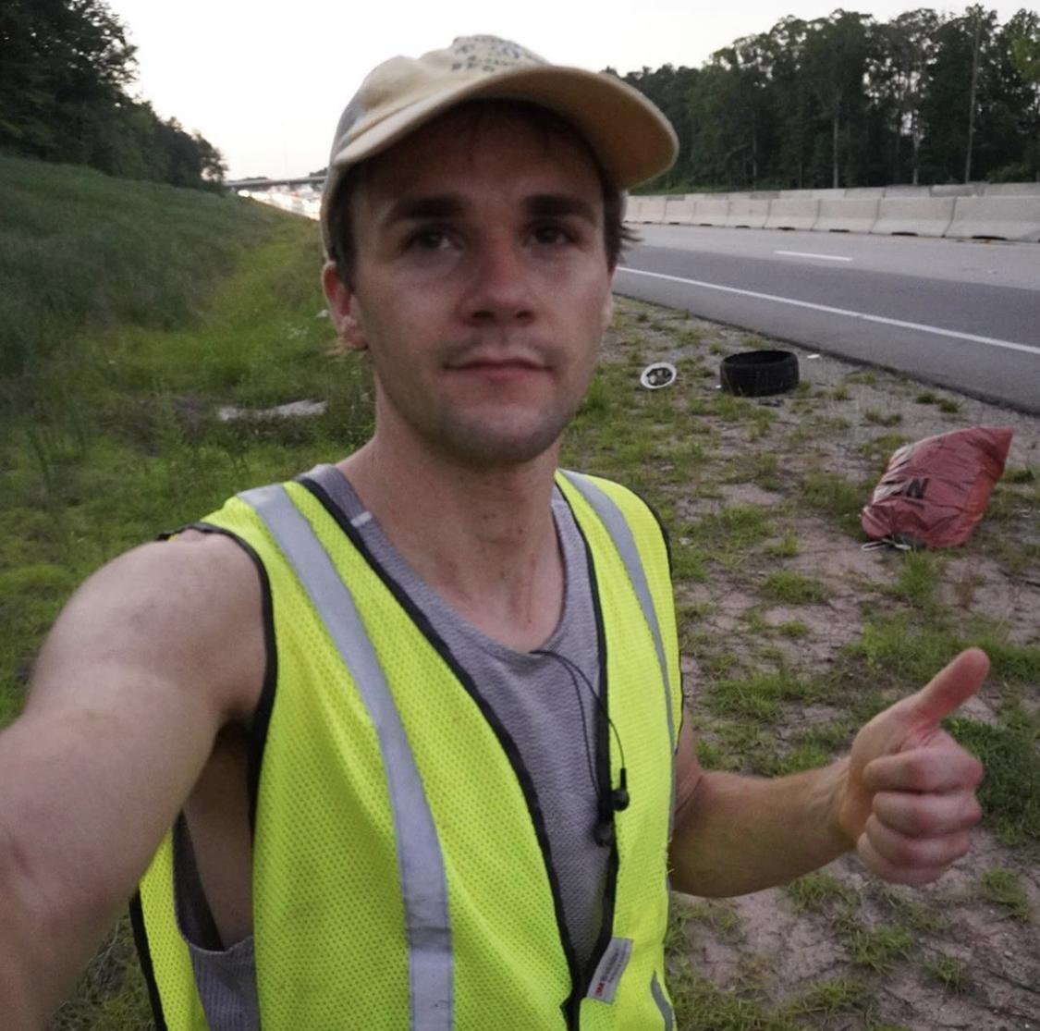
GIS Mapping of Littering
Introduction
5 minutes long
Background, Social media, Volunteerism, Accomplishments, outreach.

Slide 3
Let people report litter on a global map.
Connect local municipalities with automatic notification.
Mark cleanups done by the earth stewards.
Provide data to governments.
Build predictive map of littering.
Litter Map

Slide 4
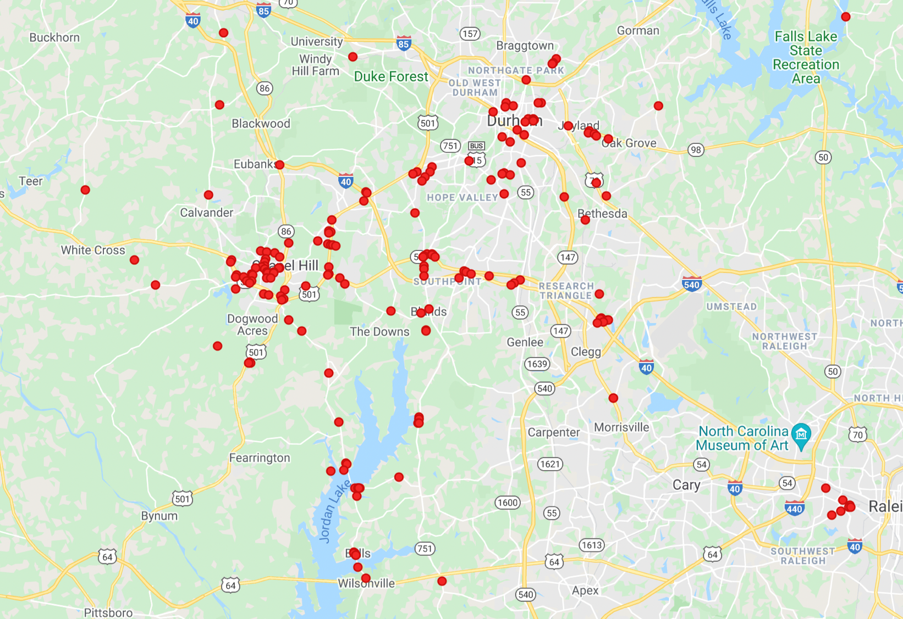
Predict where littering will occur to lead people to volunteer to cleanup there.

Slide 5
Example
Trash always begins near populated areas, and it always flows down streams away from them.
1

Slide 6
Project has three parts
Pull data
Perform logic
Output data

Slide 7
“Key:Value” Pairs
Amenity:Convenience Store
608 W. Corporation St.
36.002179, 78.903697

Slide 8
Part 1. Pull Data.
API query for “amenities” on Open Street Maps which is a free library/open source mapping project.
Download whole library from OSM
Census Reports, OpenLitterMap, Water/Current paths, Windy, Currents, Public GIS Data, more.

Slide 9
Part 2. Perform Logic
Option 1. Simply provide you with a set of rules the logic can have that will give us an accurate prediction of littering.
Option 2. Flexible framework for developing logic algorithms over time.

Slide 10
Part 3. Output Data
Output data in any format you prefer! Our goal is something we can render in ArcGIS, Leaflet JS, and Google Maps API.

