Slide 1
Pelvic Floor Smart Wand
TorchTech Industries
Notes:
Hello everyone, I hope you are all having a wonderful day. My name is Michael Weaver and I am pitching on behalf of TorchTech Industries. I apologize that we are unable to be there in person, but I assure you that we are eager about the project and hoping to work with one of your teams. Today I will be discussing our pelvic floor smart wand.

Slide 2
Meet the team
Erin Carey, MD MSCR
Devin Hubbard, PhD
Nicole Wiley, MS
Jenn Harrington, PT
Delaney Cowart, BS
Michael Weaver, BS
Notes:
TorchTech Industries is a small team started by seniors at UNC during their Biomedical Engineering Capstone Project. My colleague Delaney and I have since graduated and we have expanded our company to include the doctors, professors and professionals that you see here on your screen. We are extremely excited to combine different disciplines within the UNC system in an attempt to improve the quality of life for millions of people around the globe.

Slide 3
Current Market for pelvic floor dysfunction
Current competitors in the high tone market are mechanical devices that perform myofascial trigger point release.
Notes:
Here at TorchTech we are focused on addressing the gaps in women’s reproductive health, and specifically, within the disease state of Pelvic Floor Dysfunction. Pelvic floor dysfunction is when the muscles of the pelvic floor become too weak (hypotonic), too tight (hypertonic) or even torn due to trauma to the pelvic floor, resulting in a lack of coordination and pain. The total addressable market for pelvic floor dysfunction is currently about 5 million people. Keep in mind that these numbers are defined by only the women who completed physical therapy for their pelvic floor dysfunction.

Slide 4
Problems with Pelvic Floor physical Therapy
Lack of Understanding
Improperly Applied Pressure
Poorly Reproduced Exercises
Notes:
Pelvic Floor Dysfunction is commonly treated with Physical Therapy, using a mechanical wand to isolate and relieve areas of excessive tension that weaken the muscles at large, known as trigger points, a process which is pictured here. Imagine that this process is similar to massaging your shoulder to relieve a knot, however, massaging the pelvic floor can be an extremely inaccessible and cumbersome process.

Slide 5
PROBLEMS WITH A MECHANICAL WAND
Uncertainty on where and how to apply pressure from the wand
Uncertainty on how much pressure to apply to each trigger point
Lack of education surrounding pelvic floor physical therapy and women’s reproductive health
Inability to track progress and monitor health changes
Difficulty in remembering each type of therapy regime
Notes:
When performing therapy with a mechanical wand, patients simply cannot locate the internal trigger points that their physical therapists have instructed them to release which can then lead to further complications. In essence, the physical therapy process is perceived as way too subjective and inaccessible for the patient to routinely replicate these exercises at home.

Slide 6
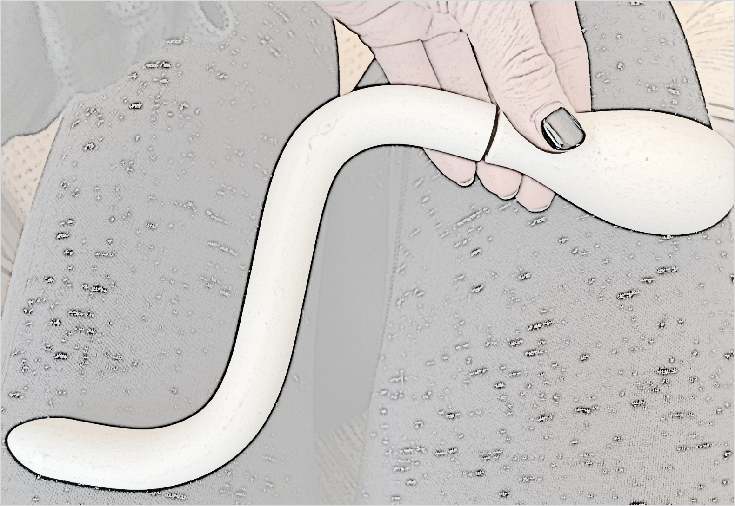
What’s our Goal?
**CONFIDENTIAL**
Create a pelvic floor smart wand and app that allows greater accessibility of at-home pelvic floor physical therapy... eliminating the need to return to the physical therapist.
Notes:
As such, here at TorchTech, our goal is to create a pelvic floor smart wand and associated app that allows greater accessibility of at-home pelvic floor physical therapy... eliminating the need to return to the therapist. To clarify, the curved, smart wand will be inserted into the vagina and pressed into the vaginal wall in order to perform the trigger-point release therapy on the tight pelvic floor muscles; and the app will allow patients to monitor the wand’s actions in real-time and ensure that the therapy is being administered properly.

Slide 7
. . . That’s Where you come in!
**CONFIDENTIAL**
A SmartWand with:
Pelvic Muscle Mapping &
Real Time Feedback
The addition of a phone application is the novel aspect of our therapeutic approach...
The collaboration of the wand and app will help eliminate therapeutic ambiguity and maximize the efficiency of at-home therapy!
Notes:
And as you might have guessed… that is where y’alls expertise comes into our mission. We need help developing a mobile application that will communicate with our wand and maximize the efficiency of at-home pelvic floor physical therapy!

Slide 8
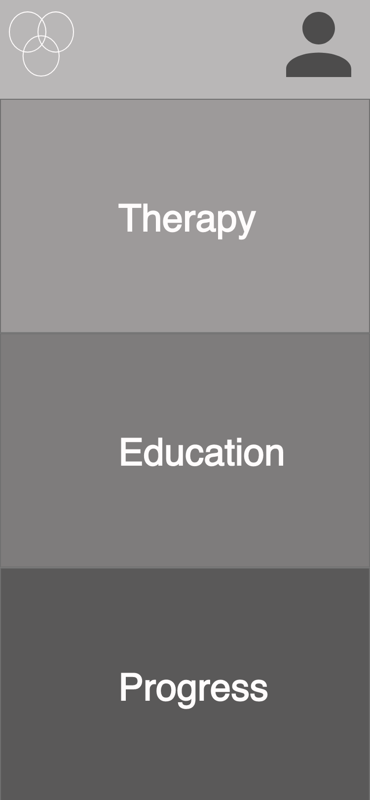
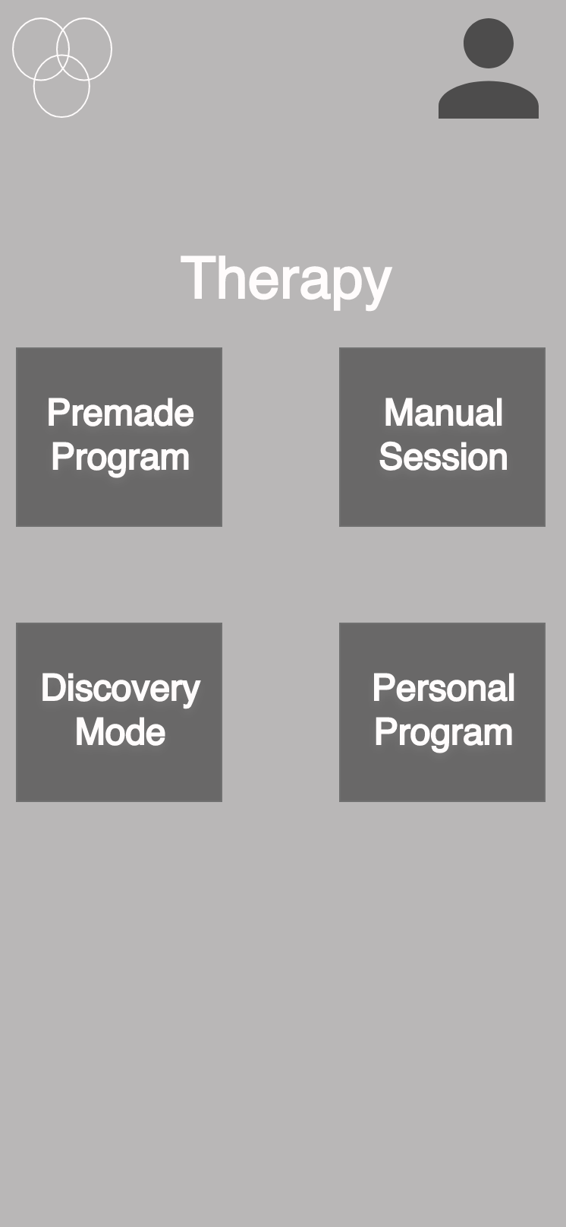
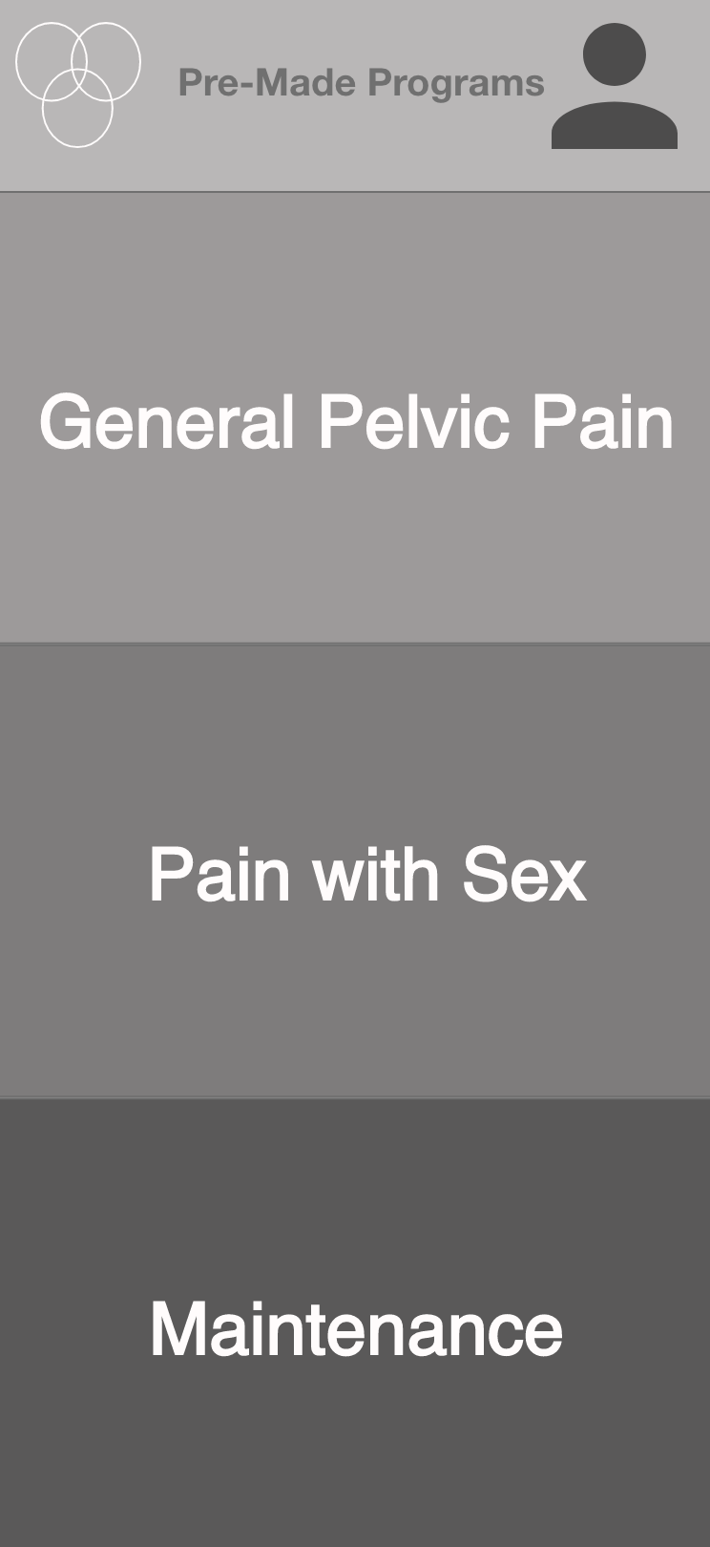
The APP:
**CONFIDENTIAL**
Preliminary Wireframe:
Communication
Accessibility
Education
Notes:
Seen here is an extremely basic wireframe of a few screens within the app. We would like the app to center on communication, accessibility and education.

Slide 9
Applying your computer science education:
Notes:
So how will this project allow you to utilize your computer science education?

Slide 10
Building a Progress Tracker
Implementing Exercise Programs
Programming the Solution
Via bluetooth:
Wand Calibration, and Live BioFeedback
Stores Personalized Accounts
**CONFIDENTIAL**
Notes:
Well… y’all will be programming the solution. Over the next few months, your team would work with us to:
Implement and embed the different exercise programs that are designed by our pelvic floor physical therapists and OBGYN.
Build a real-time progress tracker that will help patients visualize the effects of their therapy
Build a software that can be accessed by countless personalized accounts of each patient and store the data of each account
And lastly, we will need your help calibrating the wand to the app, and ensuring that the bluetooth capabilities of the device allow it to effectively transmit the live biofeedback data during wand usage.
Personalized Accounts: use a product code to log in, register device, and connect a personal account to the product

Slide 11
Deliverables
Basic
Advanced
**CONFIDENTIAL**
iOS and Android mobile application
Interactive and graphic-based interface
Receive and store bio-based data from the wand
Bluetooth
Personalized
Implementing and formatting therapy programs
Inclusion of maps of the pelvic floor that will direct wand placement during therapy
Inclusion of a health forum that can be edited and used by clinicians and patients
Notes:
We understand that these are some tall tasks to be tackled in 3 months, so we have split the deliverables into a basic category, and a more advanced category if project time permits.
First and foremost, we would like your team to develop an interactive and graphic-based mobile interface that can be run on iOS and Android.
We would like this app to be personalized to each users account, allowing it to receive and store the respective bio-based data generated during each therapy session
And we would like some initial therapy programs (that will be provided by our clinicians) to be formatted and embedded into the application.
If these tasks prove to be too basic for an ambitious team,
We would also like the app to include illustrated maps of the pelvic floor, that will be provided, to help direct internal wand placement during therapy.
Lastly, we hope that the app may also include a forum that can be edited and used by clinicians and patients to help raise awareness and spread knowledge concerning pelvic floor dysfunction and reproductive health.

Slide 12
Thanks
Do you have any question?
Email: TorchTechIndustries@gmail.com
Cell: 614-381-7897
Notes:
Before departing, I would like to emphasize that we are extremely excited to combine different disciplines within the UNC system in an attempt to improve the quality of life for millions of people around the globe. As UNC alumni, we understand that all of these deliverables may not be feasible as you have other obligations during the semester. We would like to give y’all control over this project and we will serve as points of contact and information throughout the process. Seeking a relaxed atmosphere of collaboration, we are open to any and all ideas you may have, and we can be flexible regarding the final deliverables of the project. Thank you all for your time and attention. If you have any questions, please don’t hesitate to contact us at the email provided or via my personal cell-phone number. Thanks!

