Slide 1
Motivation
你是什么东西？
我是你蝶
JoJo Yang | Yichen Yu
Notes:
Hi I’m JoJo Yang.
Hi I’m Yichen Yu.
We are seniors from the Journalism school and we are here to introduce our project, Motivation. This is our second time here, we have worked on this projects with COMP 523 students in the previous semester.

Slide 2
AGENDA
OUR SOLUTION/WHAT WE HAVE NOW
WHY PICK US?
OUR INSPIRATION
WHO/WHAT ARE WE LOOKING FOR?
Notes:
For our pitch, we will be talking about the following topics:
Our inspiration
What we have now
Who we are looking for and
Why you should pick us

Slide 3
SERU COVID-19 SURVEY
Problems
96%
22,519 undergraduates
88%
7,690 graduates
“faced at least one obstacle during their transition to online learning format.”
Lack proper environment
Lack friends & peers
Lack stable mind
and, definitely
LACK MOTIVATION
Notes:
We started this project in a ux design class that we took in Fall 2020 at the Journalism school. Since we were remote that semester, we wanted to make our final project around helping college students navigate in a remote learning environment. After observing college students on social media and handed out some survey, we realized the most predominant issue students had with online learning is the lack of motivation. We also studied the Student Experience in the Research University (SERU) survey that was taken by more than 30 thousand college students. More than 22 thousand undergrad and 7 thousand graduate students said they faced at least one obstacle during online learning which the lack of motivation was one of the largest reasons founded by the survey responses.

Slide 4
MOBILE APP—MOTIVATION
Target Users
Connect with others in the university and study together with higher efficiency
Improving college experience and achieving both academic and mental health
University Students
Notes:
This is our inspiration for Motivation. Our main target users are university students and we are have two main goals.
First, we want to help college students form good habits.
Second, we want to create a student-friendly platform that can support students to achieve academic and mental success.

Slide 5
MOTIVATION
Tracker
Calendar
Group Chat
User Center
Habit list
Check-in habits
Create new habits
Monthly overview
Buffer function
Join groups
Focus session
Reward system
Friends’ list, settings
Notes:
We’ve developed a well-structured sitemap for our solution. In general, the application will be divided into four sections
A tracker system where users can create and monitor their own habits
A calendar system that gives you a monthly overview of your progress.
A group chat where users can talk to other users
A user center where user can access the reward system and other app settings

Slide 6
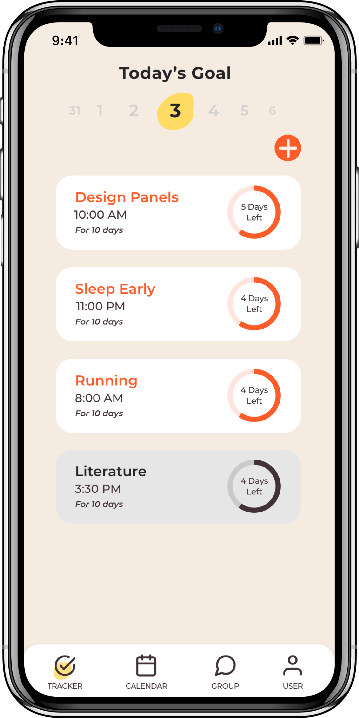
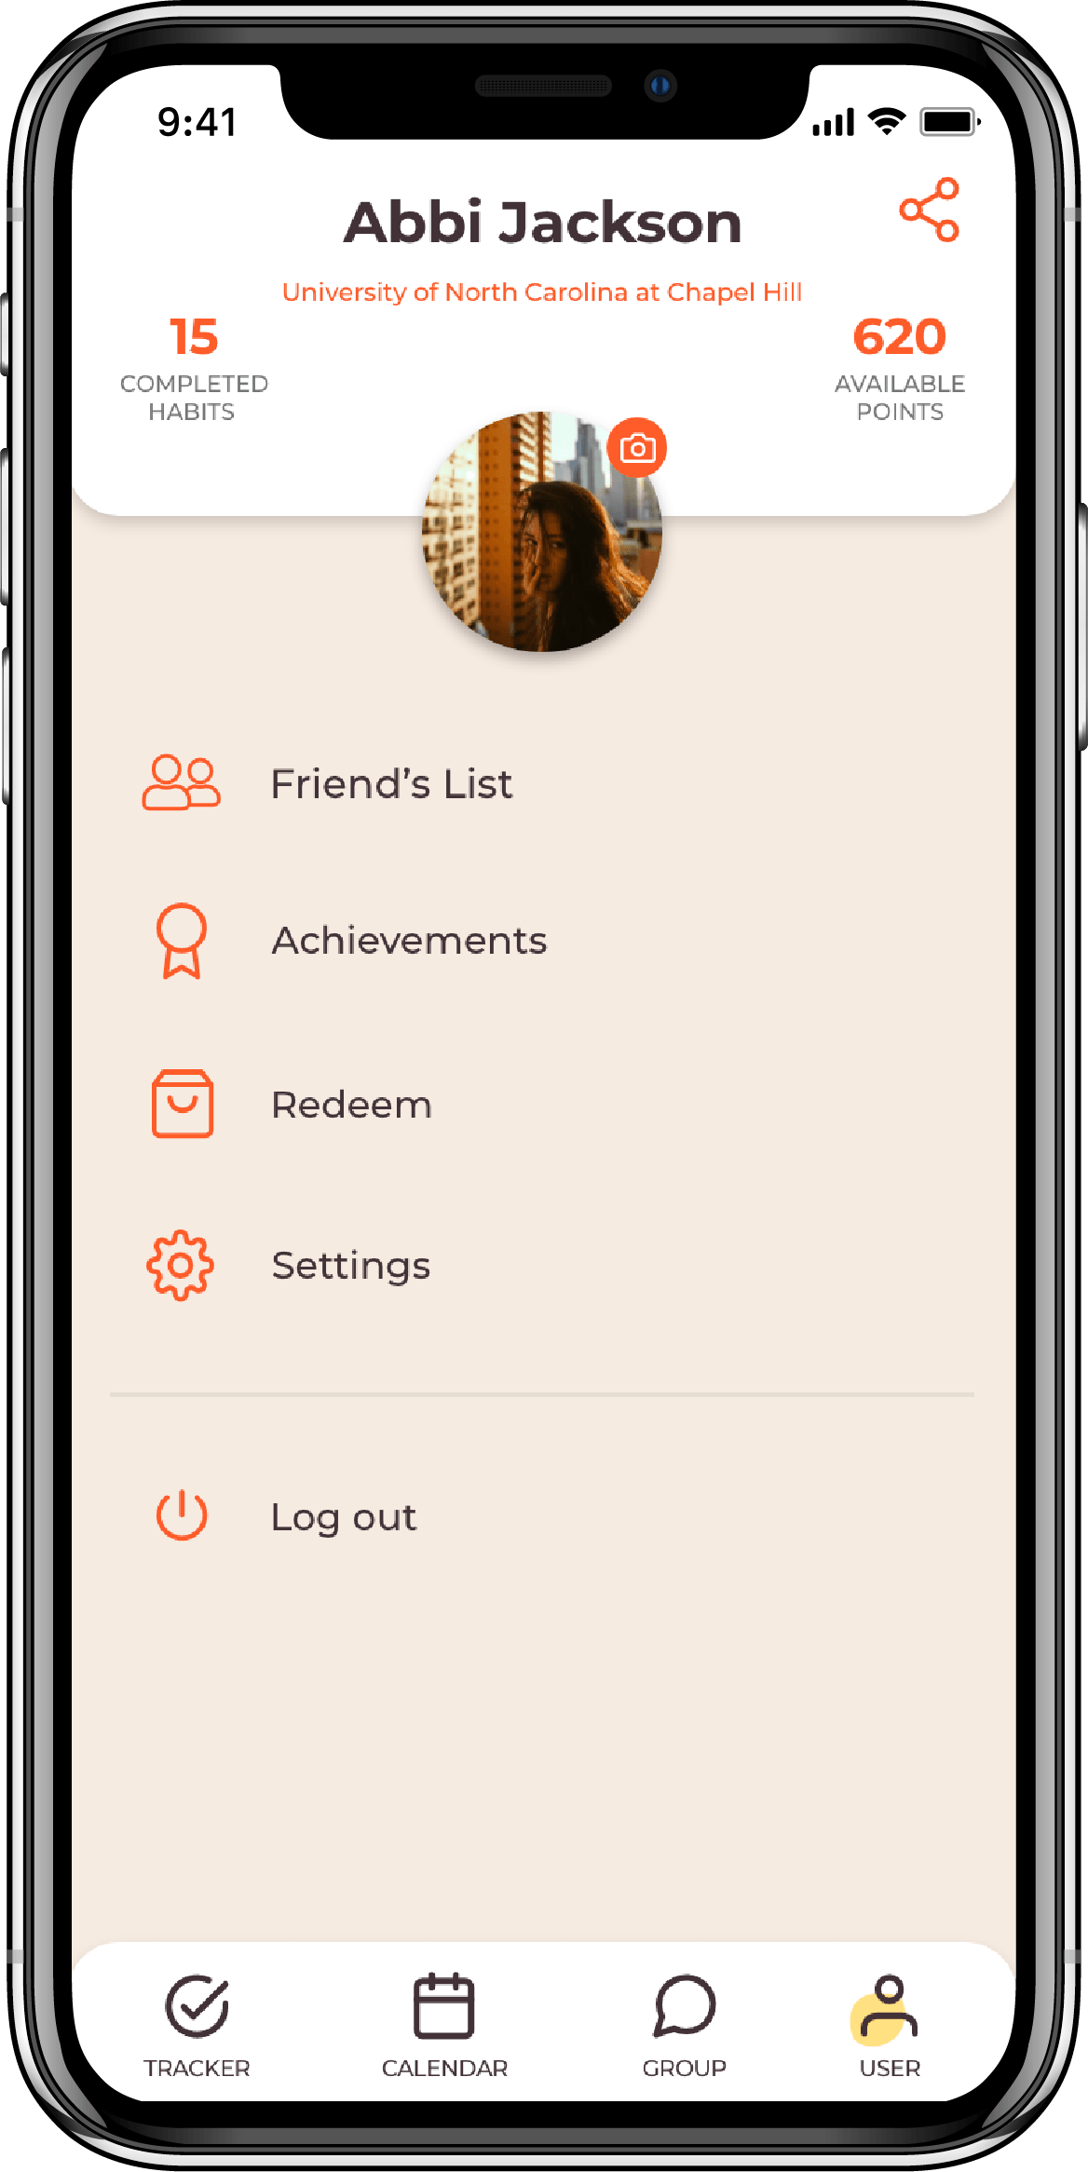
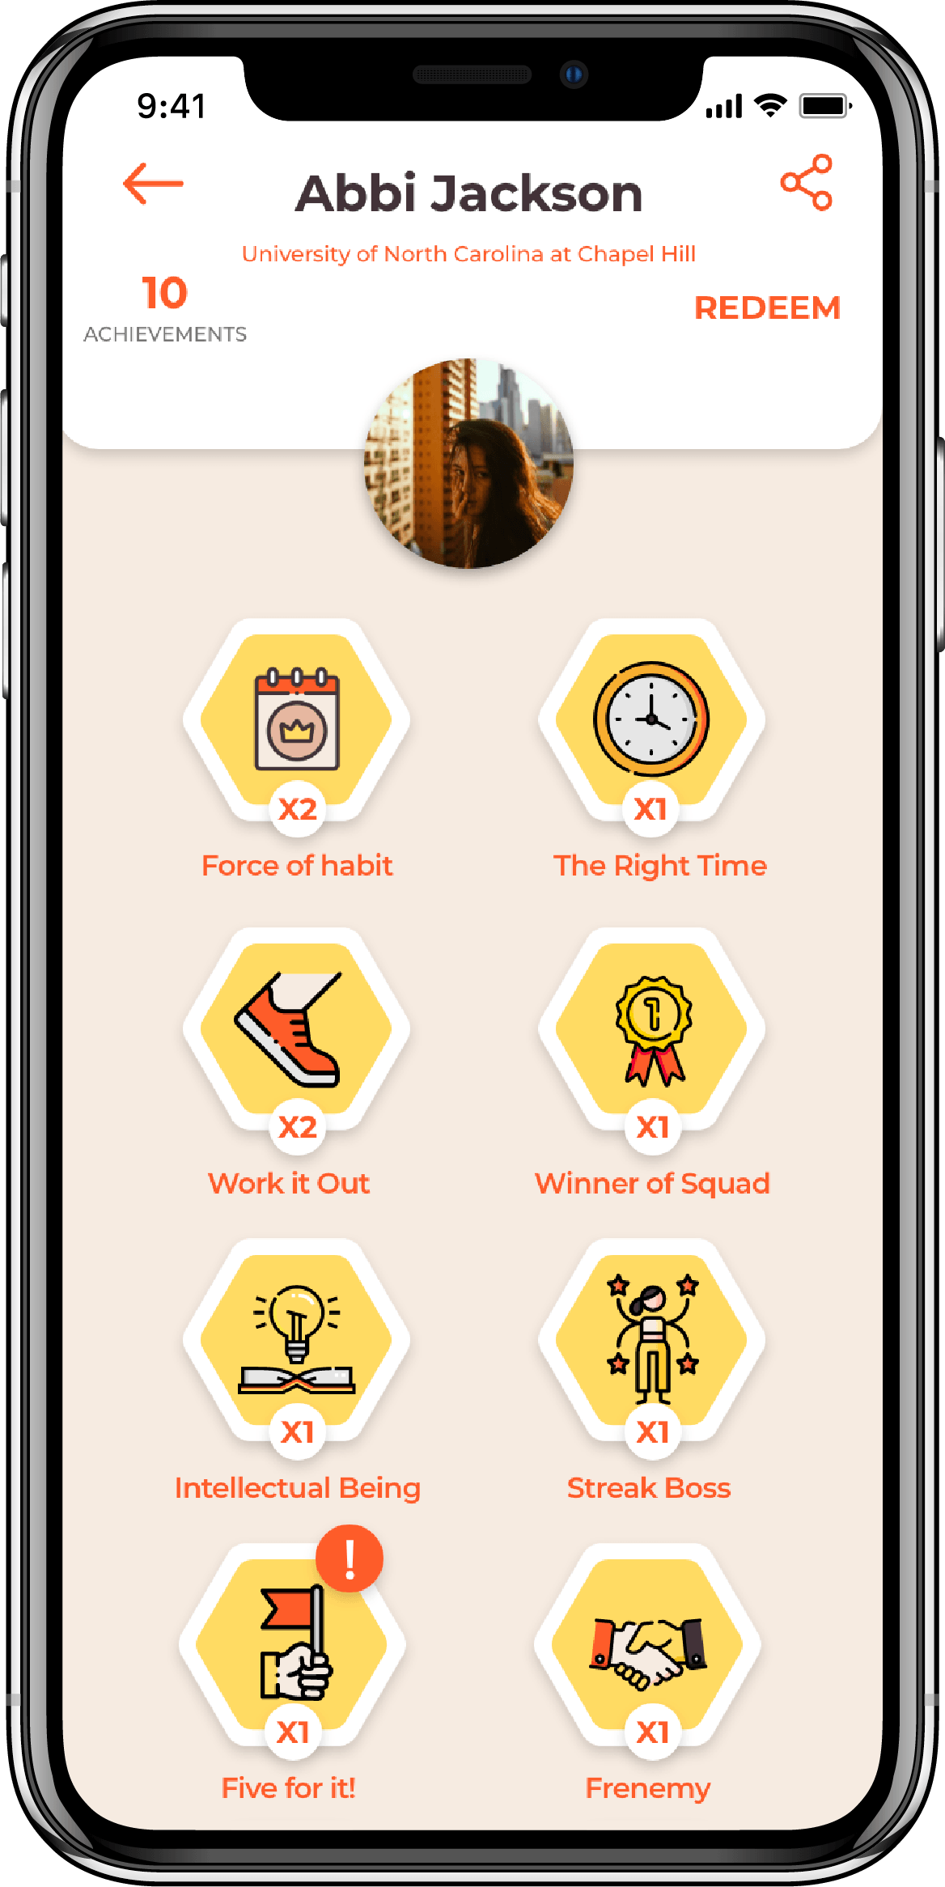
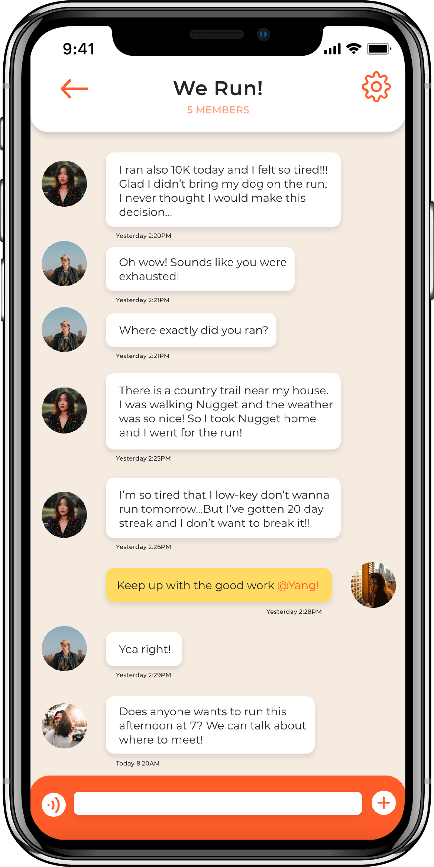
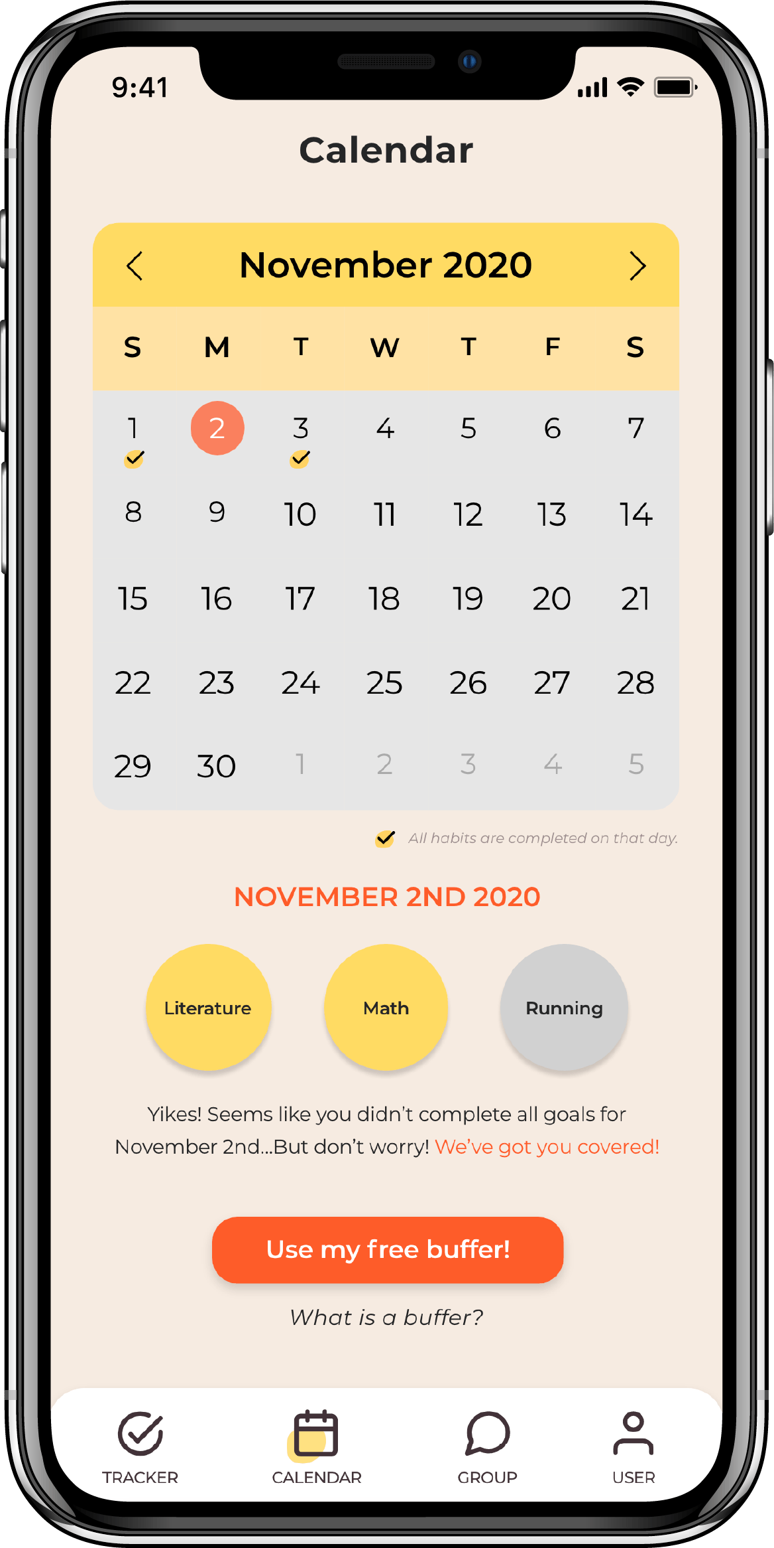
Notes:
Here are some user interfaces that we designed in Adobe XD.

Slide 7
WHAT ARE WE LOOKING FOR?
Languages/Platforms
Current Stage
React Native
Large portion of backend
Firebase
Limited frontend
Detailed Documentation
Notes:
As returning clients, we are looking for engineers to continue building on what we developed last semester. Let me introduce briefly about our current stage:
A large portion of backend and database has been implemented with Firebase
Limited functionalities have been implemented on part of user interfaces
Base on everything we have now, we’d like to continue use React Native and Firebase to build on what they left last semester. So this semester, the first priority will be built out the rest of user interfaces and make them function. Meanwhile, you’ll continue to complete the database structure. The last team has left detailed documentation with video tutorial to help you easily catch up with everything.

Slide 8
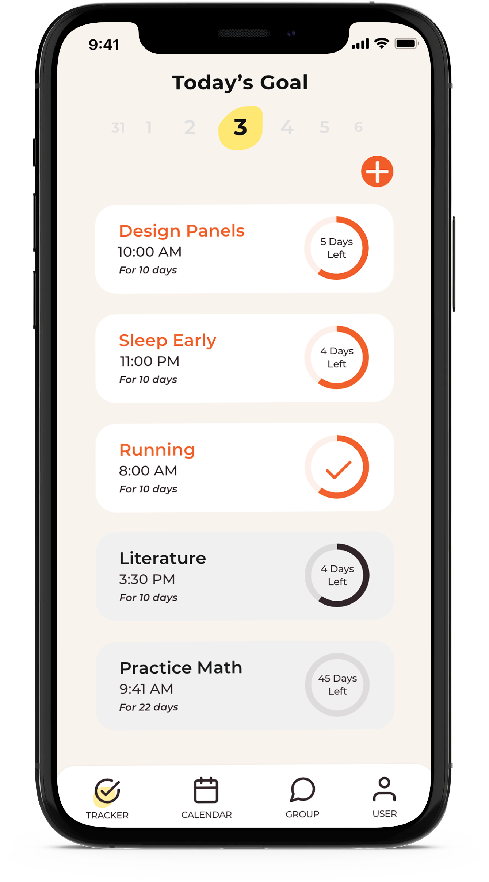
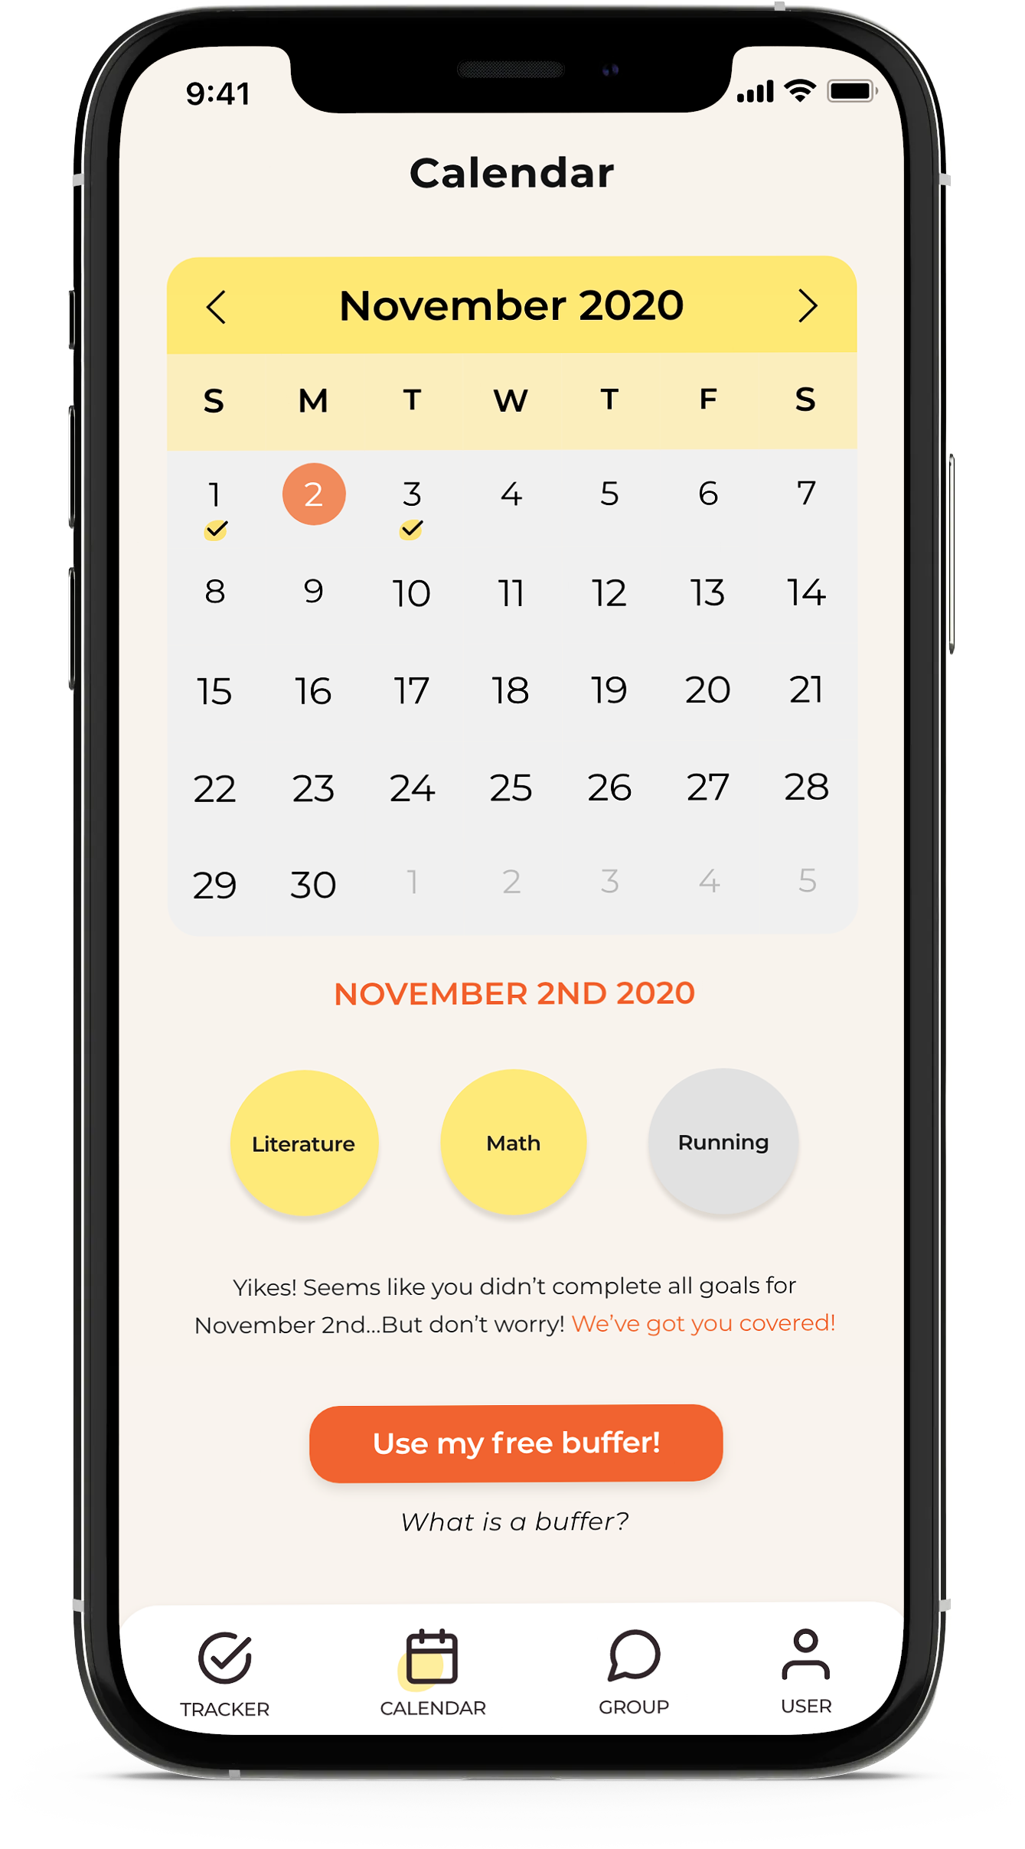
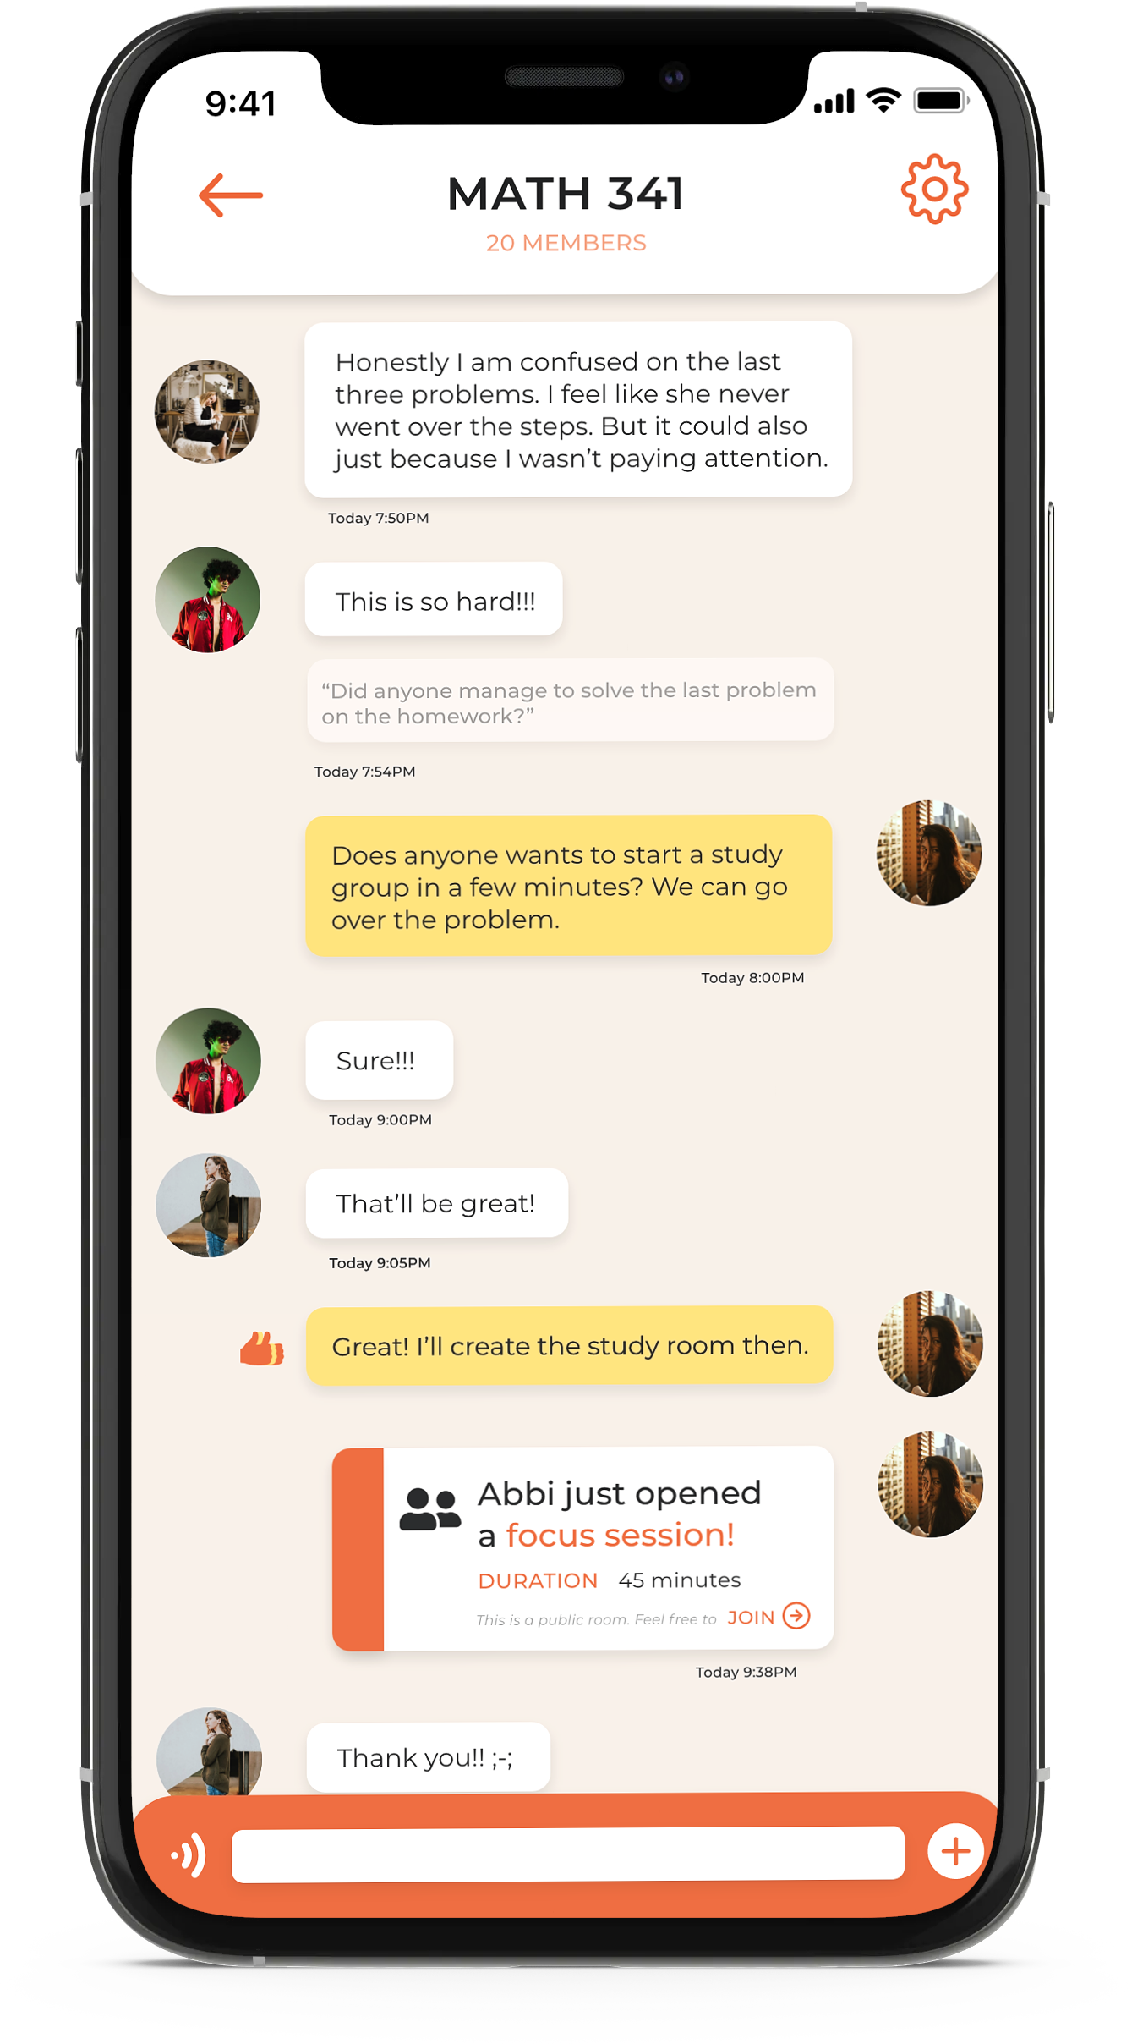
WHY PICK US?
User
Research
Working prototype
We have good foundation
We know you the best!
Notes:
We are also aware that we are being picked by you. So we have done our part to make working with us a more convenient experience.
We have done user research which include asking real people to try out our prototype and done survey to gain better user feedback.
We got a working prototype that in Adobe XD that we think is going to be helpful in development.
And lastly, we’ve worked with students from this class before, so we do somewhat know the process in this class. The students who worked on this project last semester has laid a good foundation, which we think will make the development process more smooth.

Slide 9
Yichen Yu
THANK YOU!
JoJo Yang
yichenyu@live.unc.edu
(919) 519-6878
jojoyang@live.unc.edu
(252) 561-5090
Notes:
here is the end of our presentation. If you are interested in joining us or have any questions, our emails and phone number are right here. Thank you.

Slide 10
CURRENT STAGE
Notes:
We were clients to COMP 523 last semester, and this semester, we hope we can work with you again!
A large portion of backend and database has been implemented with Firebase
Limited functionalities have been implemented on part of user interface
This semester, the first priority will be built out the rest of user interfaces and make them function
Meanwhile, you’ll continue to complete the database structure
The last team has left detailed documentation with video tutorial to help you easily catch up

Slide 11
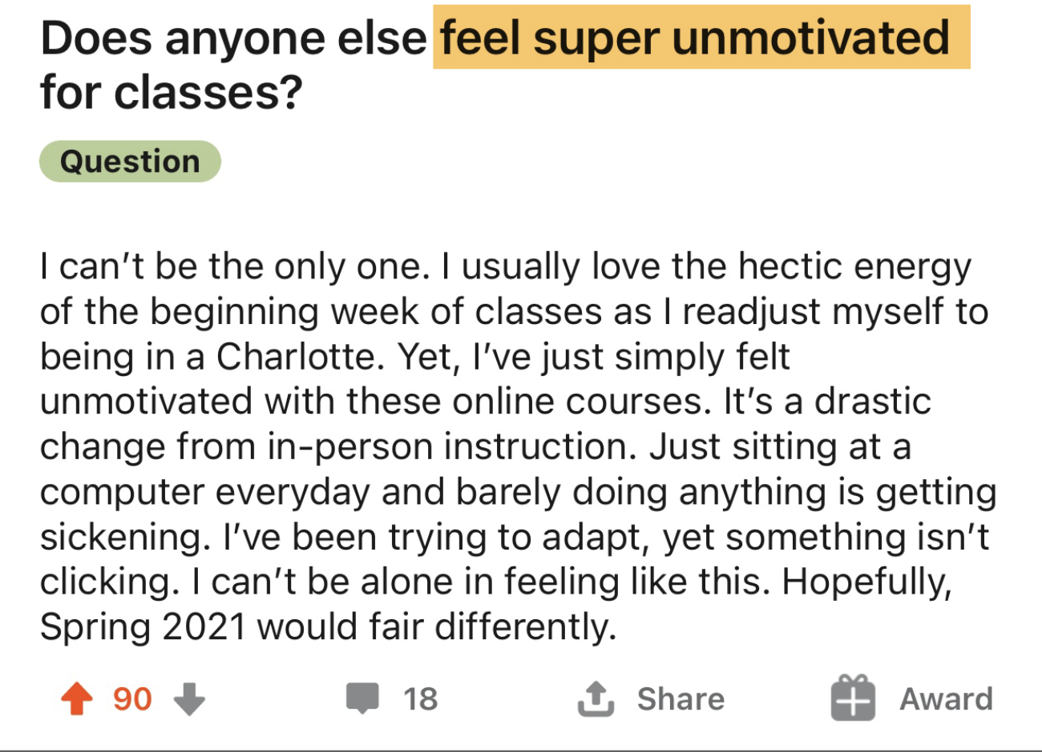
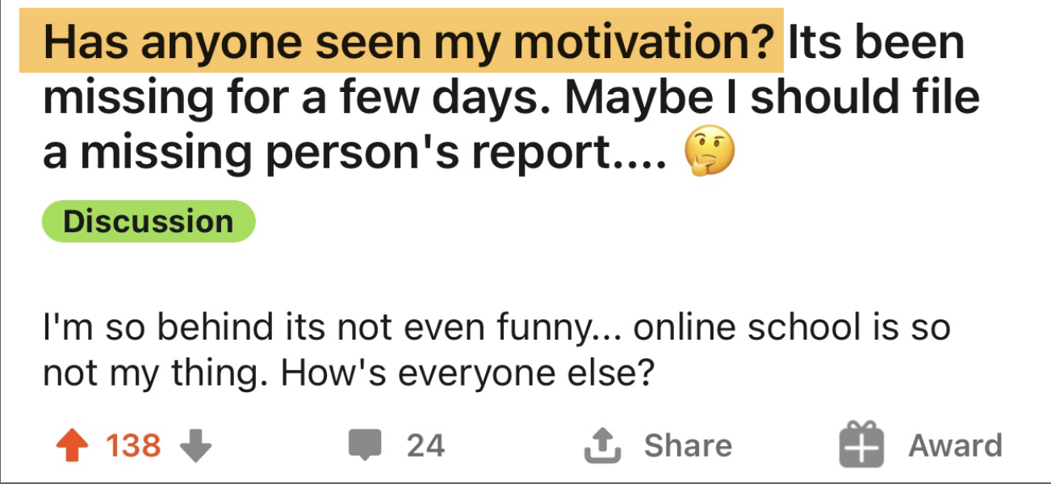
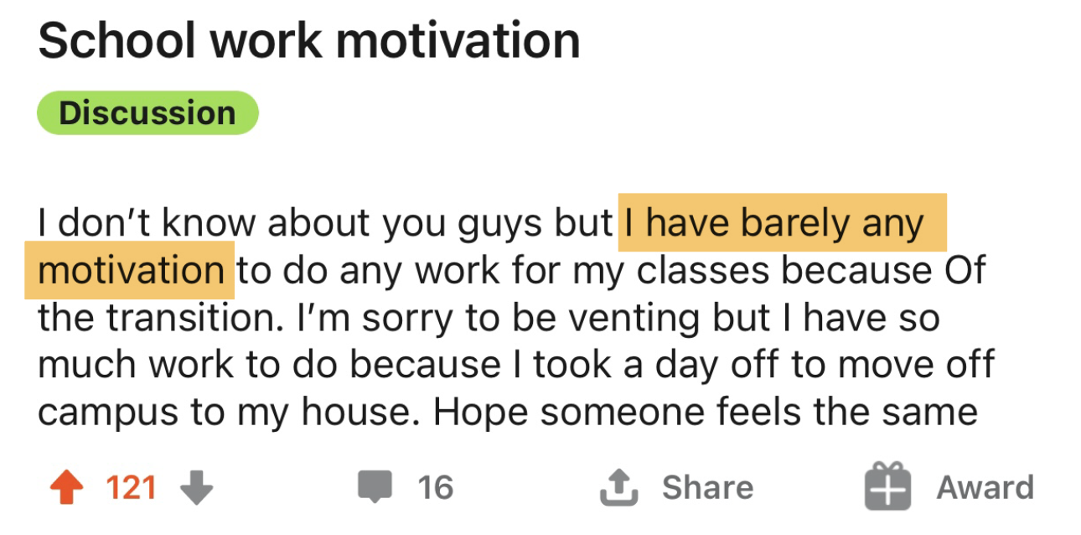
Do you feel unmotivated
during the pandemic?
Notes:
It’s not hard to see how the pandemic has affected our college experience. As students, we also missed those days we breathe freely and keep up with our routines and homework tightly.
Though this semester, things get changed a little bit, we still faced a lot difficulties.
We feel like it is impossible to stay motivated during this time. We were curious about how our peers feel. Here are what we saw on Reddit: (click)
Feeling super unmotivated (click)
Has anyone seen my motivation? Its been missing for a few days. (click)
I have barely any motivation. (click)
It seems like there are MANY students like us are feeling unmotivated and stressed during pandemic.

Slide 12
Problems
Needs
Lack proper environment
Lack friends & peers
Lack stable mind
and, definitely
Need formation of good habits
Need interaction with others
Need to be organized
thus,
LACK MOTIVATION
NEED EXTERNAL HELP
Notes:
/--From the posts in the reddit and the survey, we tried to identify the source of unmotivation. We found out many students don’t think they are in a proper environment to study, they lack social interactions, and don’t have a stable mind. As a result, students are feeling unmotivated to complete assignments and other daily habits.--/
However, we cannot stay with these obstacles. We need reformation of good habit, we need social interaction, and we need to get ourselves organized. But many of us have failed to do so by ourselves. SO, here, we need an external help. Our app is the external help here and we can fulfill these immediate needs.

