Slide 1
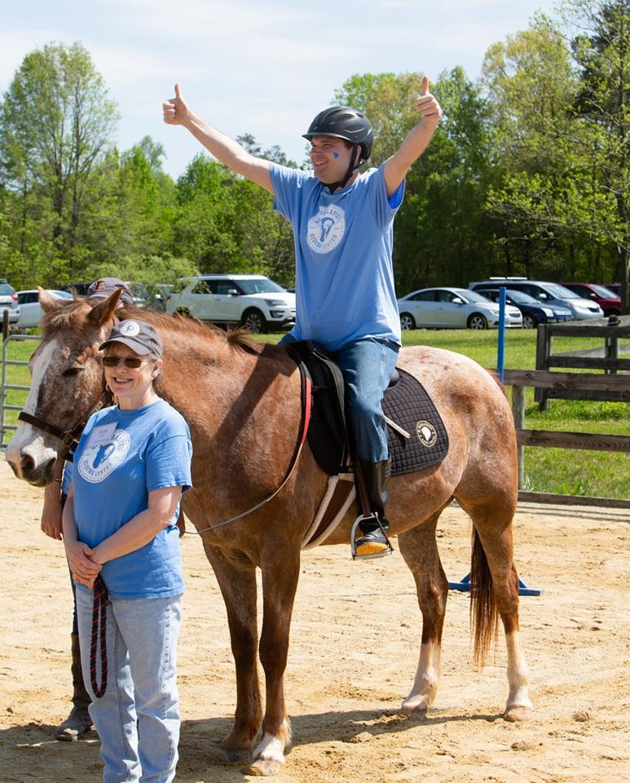
NC Therapeutic Riding Center

Slide 2
Mission
The North Carolina Therapeutic Riding Center (NCTRC) empowers children and adultswith physical, mental, emotional and social challengesto create more active, healthy and fulfilling lives through equine assisted activities and therapies.

Slide 3
Technology Need
Pre-COVID, we had approximately 100 volunteers, 80 clients, and 20 staff members coming in and out of our center each week. Post-COVID, we need an app that will allow us to check these people in, record data, and adhere with contact tracing guidelines.

Slide 4
Our Technology
We currently have three iPads that are connected to internet, which is how we will check people in/out.

Slide 5
Data We Need to Record
Answers to health questionnaire (yes/no questions)
Signature on liability release
Temperature
Time in/out

Slide 6
Other Features Needed
If people answer "yes" to certain questions, we need the app to say "you are denied entry"

Slide 7
We are very excited about this project and look forward to working with you!

