Slide 1
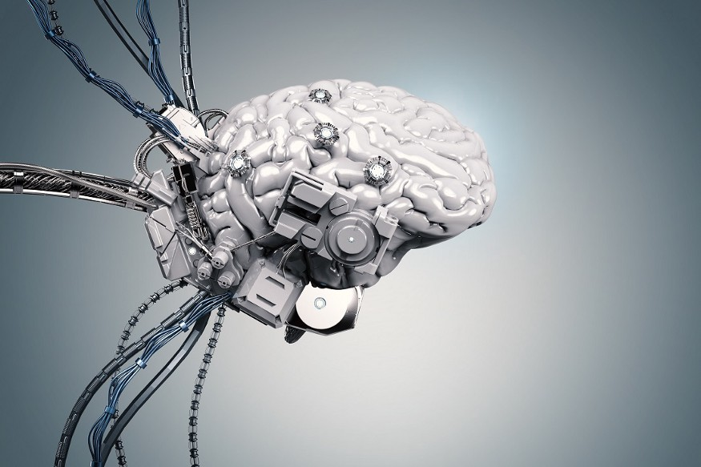
Building an Interface between User and Convolutional Neural Network-Segmented Cells and the Microscopist for Analytical Descriptions of Subcellular Time and Space
https://nulltx.com/deep-neural-network-creates-surprisingly-accurate-simulations-of-the-universe/
https://nulltx.com/deep-neural-network-creates-surprisingly-accurate-simulations-of-the-universe/

Slide 2
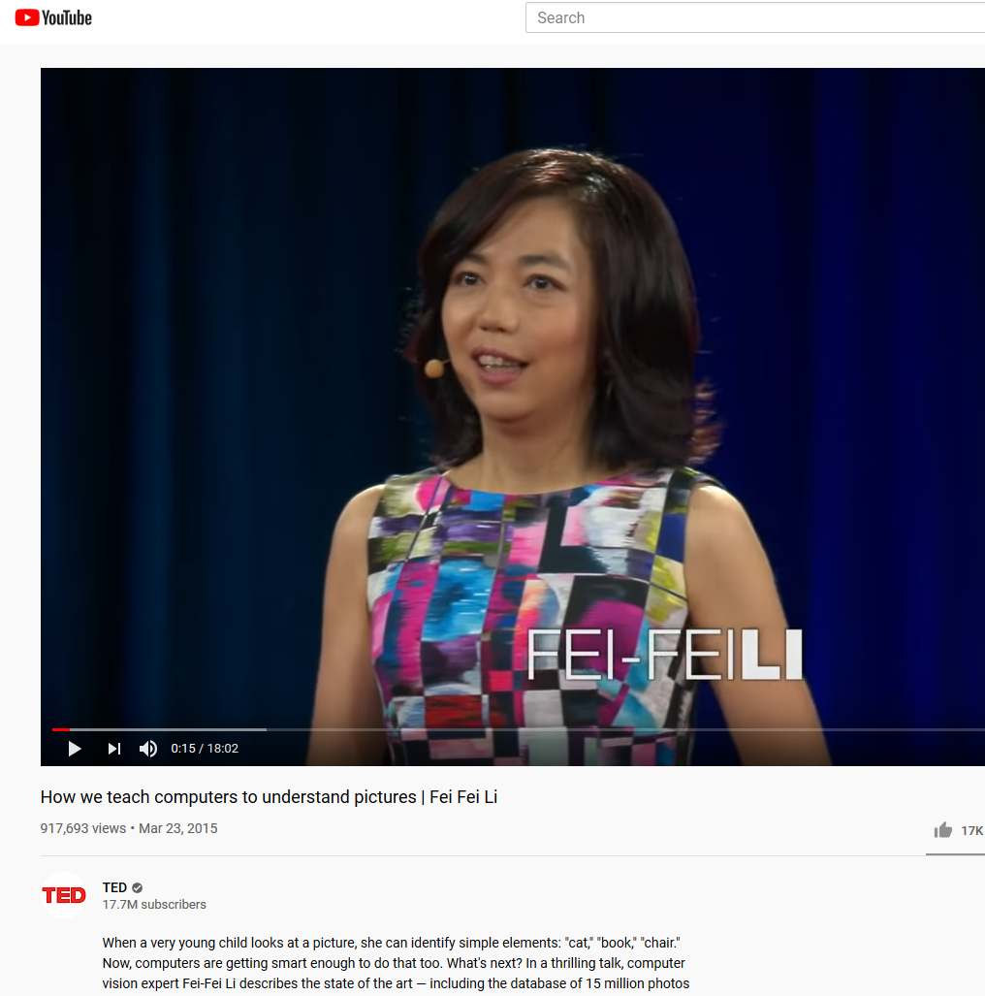
How computers learn to recognize images

Slide 3
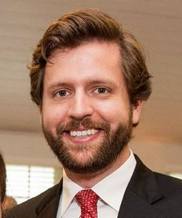
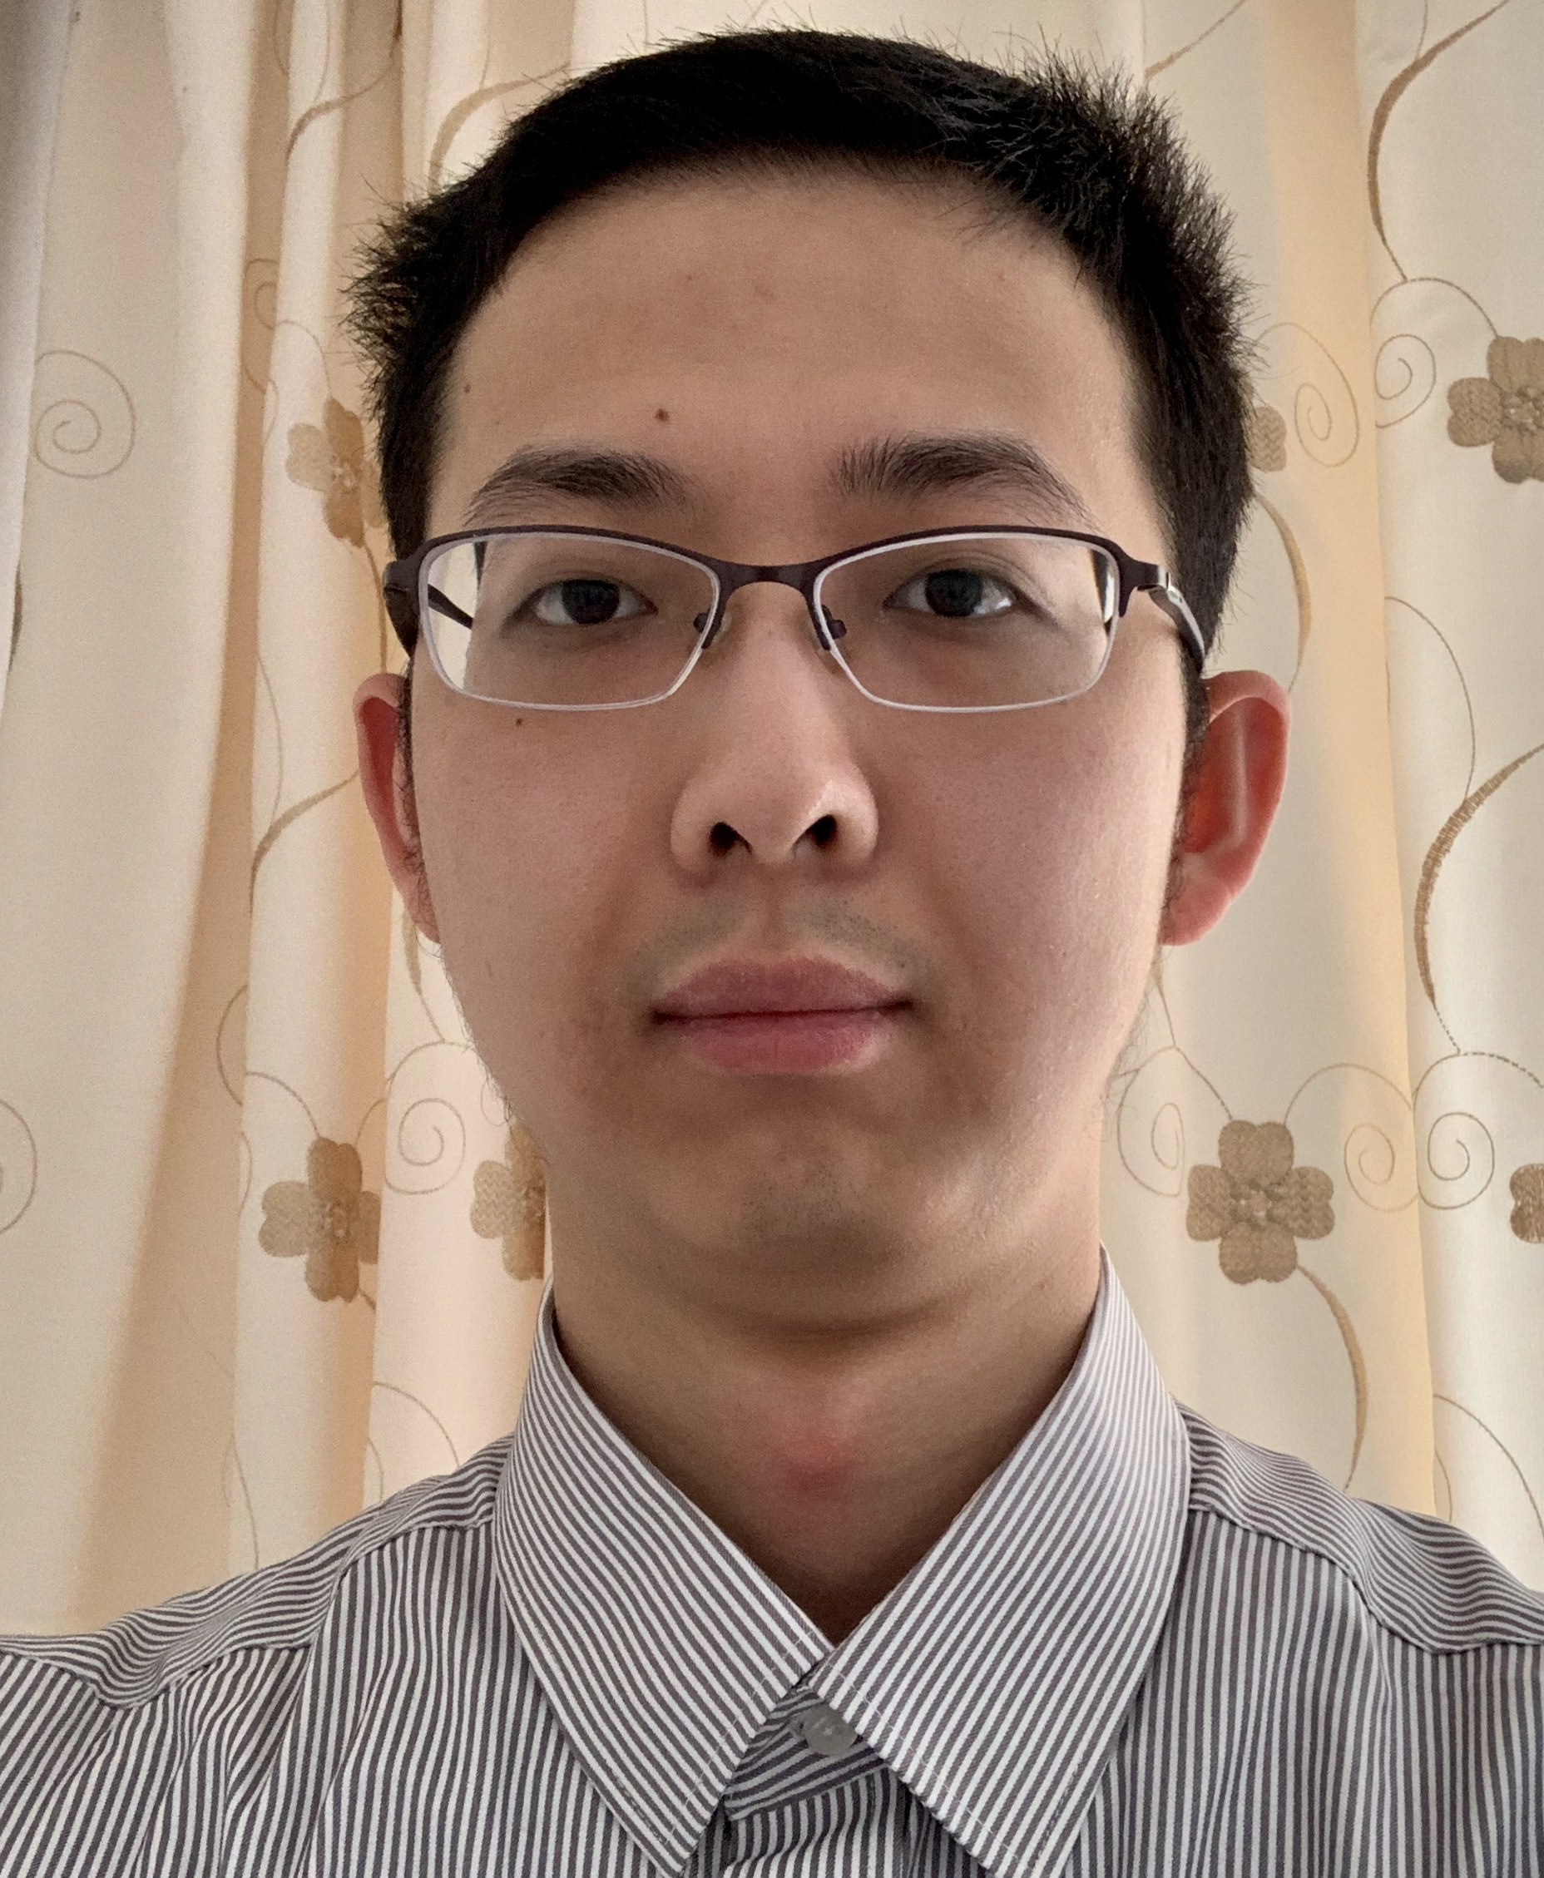
Work in Collaboration with the JonesLab Team:
Dr. Alan Jones (PI)
Dr. Justin Watkins (Advanced Microscopy)
Dr. Khem Ghusinga and Jiayi Li (Deep Learning)

Slide 4
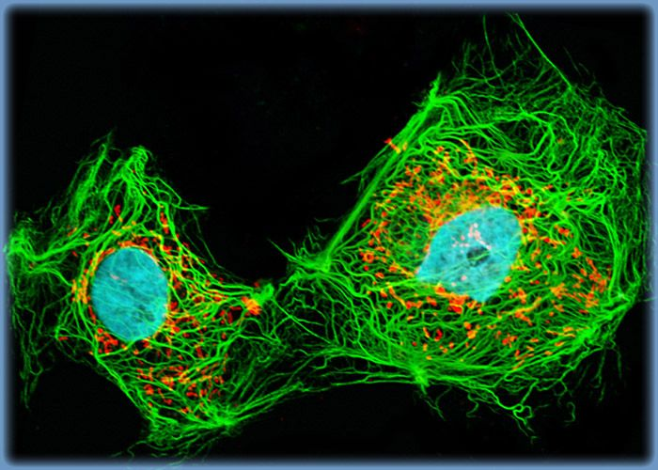
Cell Microscopy combined with Genetically-encoded Fluorescent Reporters has Positioned us to Tap into 5-Dimenional Analyses of Protein Behavior in living cells!
https://youtu.be/TY3UzihB8W0
https://www.olympus-lifescience.com/de/microscope-resource/galleries/confocal/cells/ptk2/ptk2sb3/

Slide 5
Confocal image of pastel neurons in the hippocampus of a "Brainbow" mouse brain, with each neuron expressing a distinct color. Credit: Jean Livet, 2007 Olympus BioScapes Digital Imaging Competition, Jeff Lichtman Laboratory, Harvard University Cambridge

Slide 6
Project Background
Proteins on the outer membrane leave by
trafficking into the cell (endocytosis).
We need to know how much is on the
membrane and how much is inside the cell.
To do this, we use a drawing tool to mark the
membrane vs. other parts of the cell in lots
of images to have good statistics
This takes a lot of time!
And it’s a lot of work for a human !!

Slide 7
… but computers don’t mind and they can do this faster

Slide 8
Project Background
We have already used CNN to teach a computer how to recognize a cell and we have a working program that will segment the cell to identify (annotate) the membrane, the inner cytoplasm, regions out of focus, and background.
It’s accuracy is acceptable for us to move this to a User-friendly Tool
Our program must contain a user interface to allow the microscopist to evaluate the annotation.
We start with a simple need that can later be expanded for more complex analyses.

Slide 9
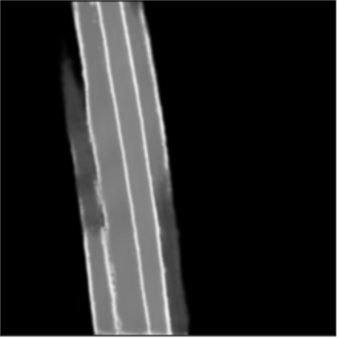
Project Background- an example of how it might look
region of interest for quantification
CNN prediction
folder/file
Select CNN
region of interest for quantification
original file
CNN prediction
export
1
2
3
1
2
3
Notes:
could choose other images from the presentation_7_27.
2. could get some inspiration for the user interface from the paper: Accurate and versatile 3D segmentation of plant tissues at cellular resolution, sent by Khem. In my opinion, It should be integrated with the graph partitioning part, which means how to manipulate the segmentation mask from CNN prediction for our purpose. The post processing could combine local (for each ROI) and global processing (for all the image). And after this customization/post-processing, the user could get the results by one or two click on the ROI.

Slide 10
Project Goal
Create a user-friendly interface that permits the microscopist to evaluate the CNN results and then to select regions of interest.
In the selected regions, we simply want to know the proportion of fluorescent pixels of one annotation vs. another.
If there is time in the semester, we would like to be able to add more sophisticated analyses

Slide 11
Project Goals
We’ve worked with a COMP 523 team on a project once before so we know how this goes.
We are confident that we will meet out goals within the semester.
But there is potential to add more functions if there is time in the semester.
This tool will be used by thousands of microscopists around the world.
We would like to submit the tool to a scientific, peer-reviewed journal for publication by December. This means you can be a co-author. For those interested in graduate school, a co-authored paper can be a “free ticket” to the school of your choice.
We are looking forward to work together with you.

