Slide 1
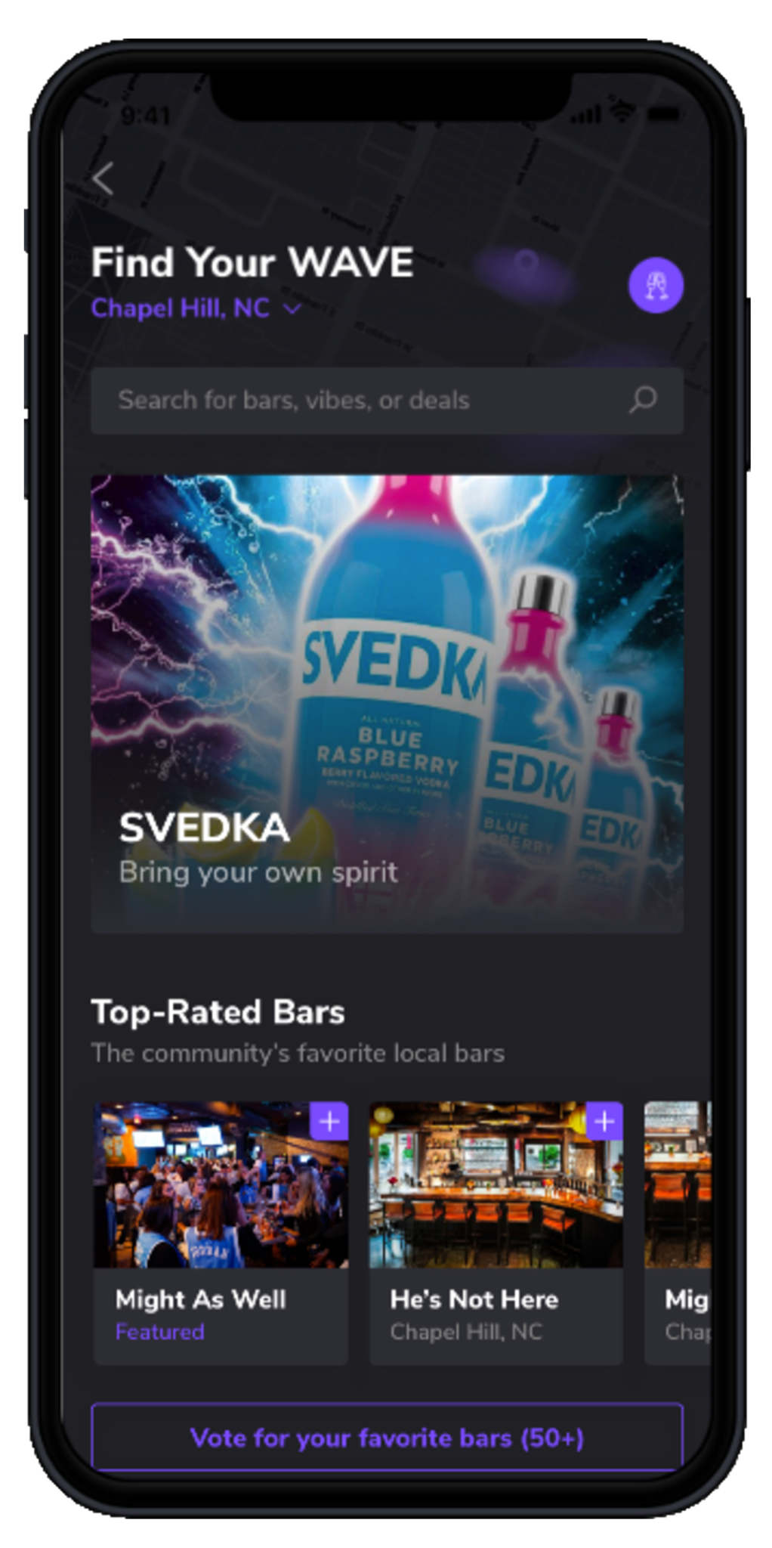
WAVE
The Next Generation of Nightlife

Slide 2
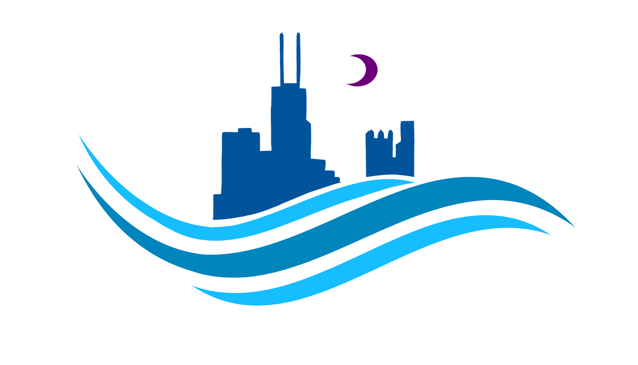
‹#›
Problems
in Nightlife
CONSUMERS
BUSINESSES
Bar goers struggle to find the best deals or most ‘lit’ venues to go to.
Trying to plan nights out is highly inefficient.
Consumers frequently end up at empty bars and miss out on the best nights.
Bars, liquor companies, promoters, and more struggle to effectively market to their consumers.
Technology has fallen behind the curve throughout the industry.
WAVE© | 2020 Copyright. All rights Reserved.

Slide 3
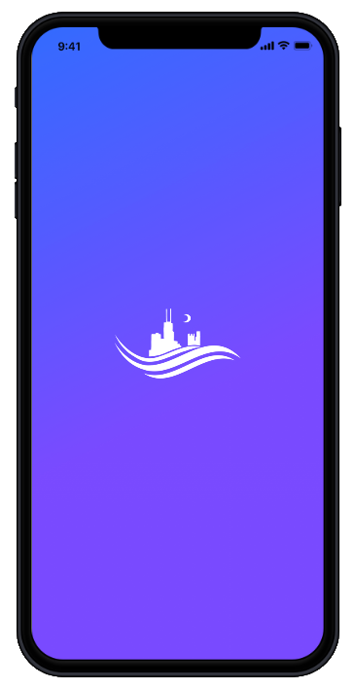
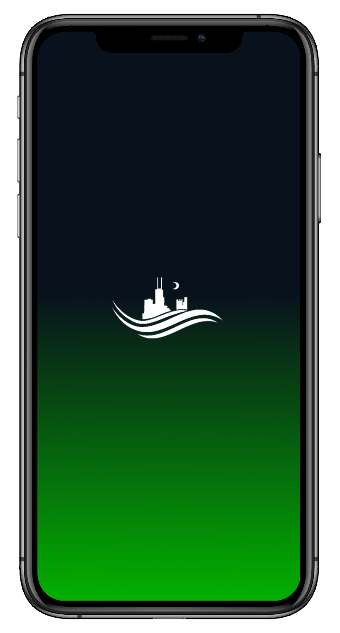
The Two-Sided
Solution

Slide 4
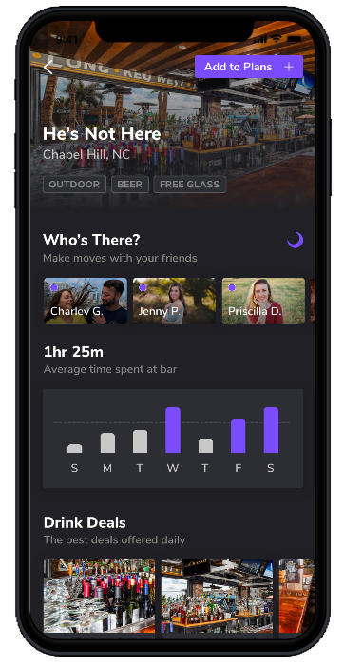
Introducing WAVE
For Bar Goers
01
02
03
Search
Check
Plan
Find the best bars and deals every night of the week
See where the crowds are before going out
Seamlessly coordinate plans with friends

Slide 5
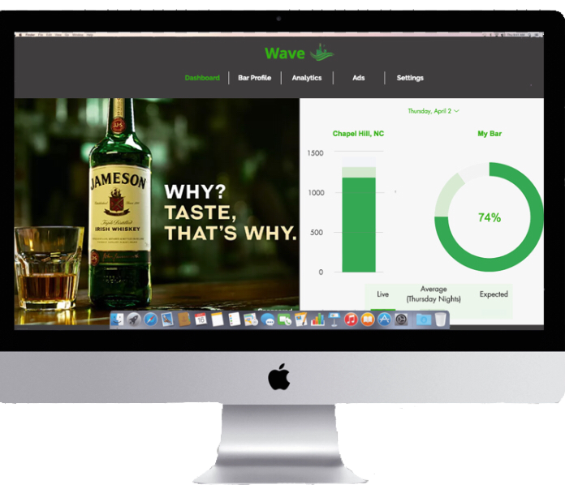
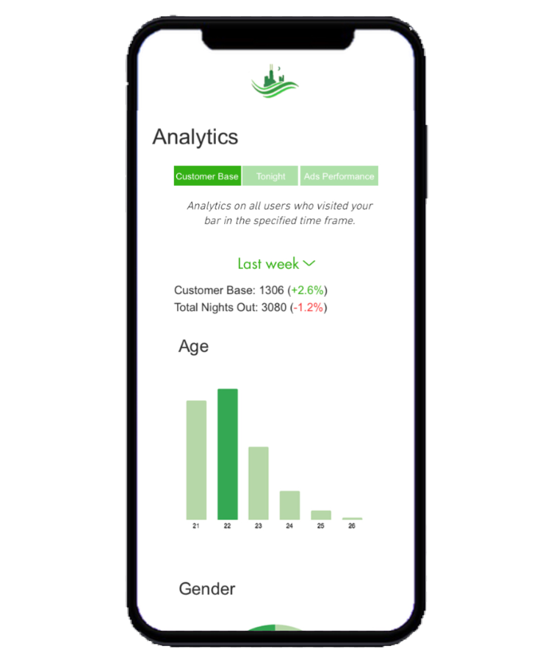
‹#›
WAVE
Business

Slide 6
‹#›
WAVE Business
The dynamic marketing channel for nightlife businesses
1
ANALYTICS
2
ADVERTISING
3
DATA FOCUSED
Powerful analytics on customer bases and competition
Highly optimized targeted advertising
Continuously analyzes data to improve performance

Slide 7
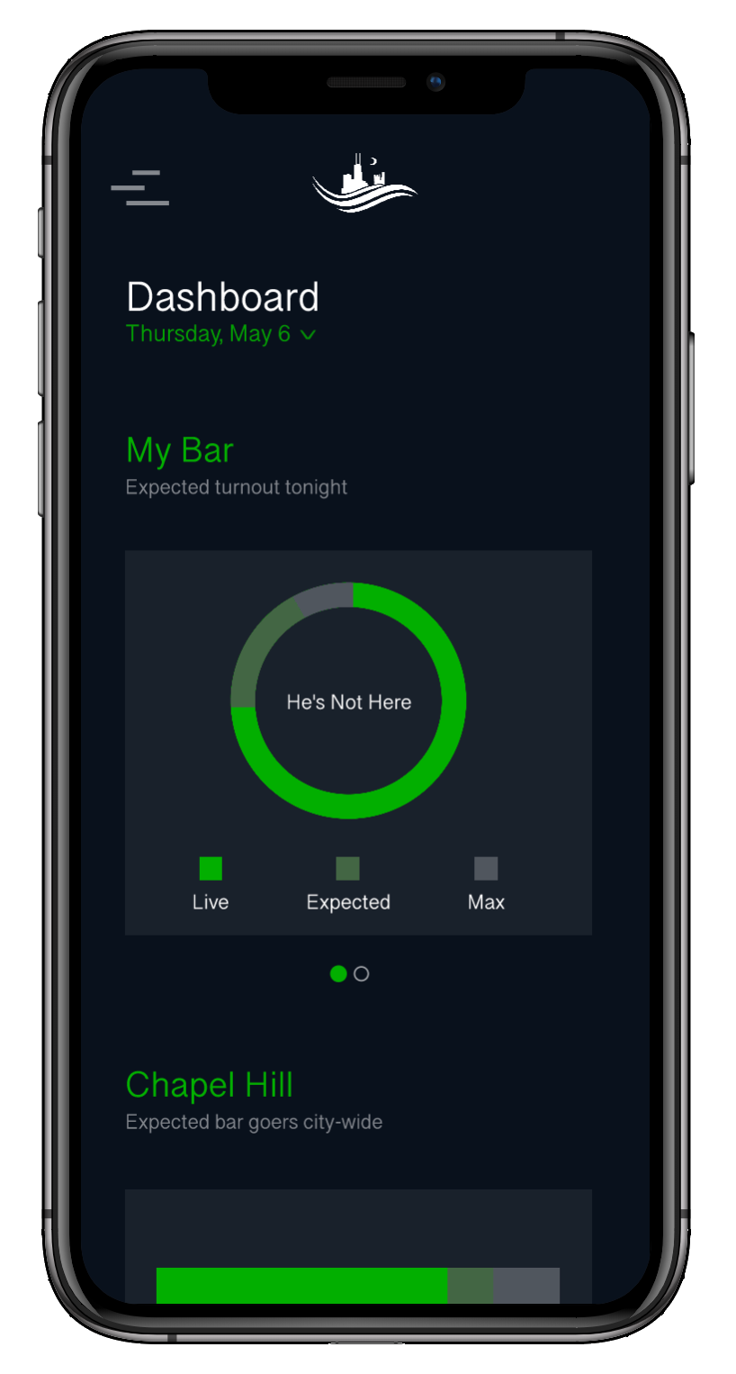
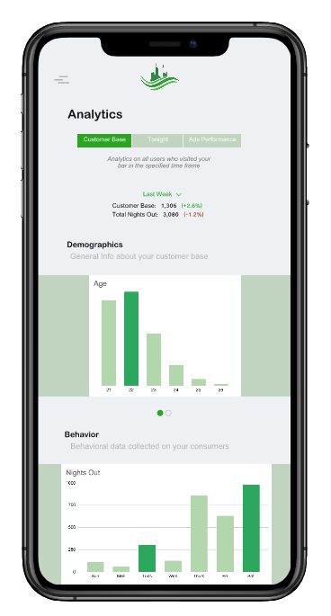
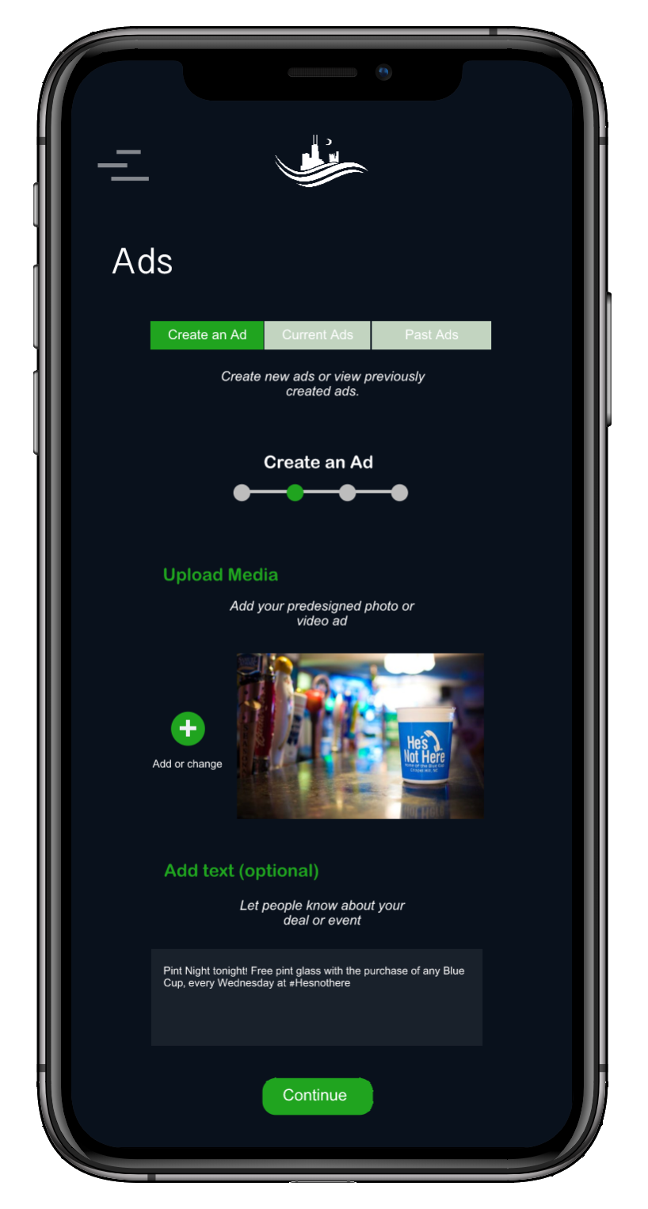
For Bar Owners
Wave uses live data from consumers making plans on the app and historical trends to provide expected turnouts for bars.
By compiling data from weekly visitors, Wave creates a ‘customer base’ for bars to view analytics on and retarget..
Wave Ads provide targeted marketing towards specified segments, such as ‘frequent visitors’, with high conversion tactics like push notifications.

Slide 8
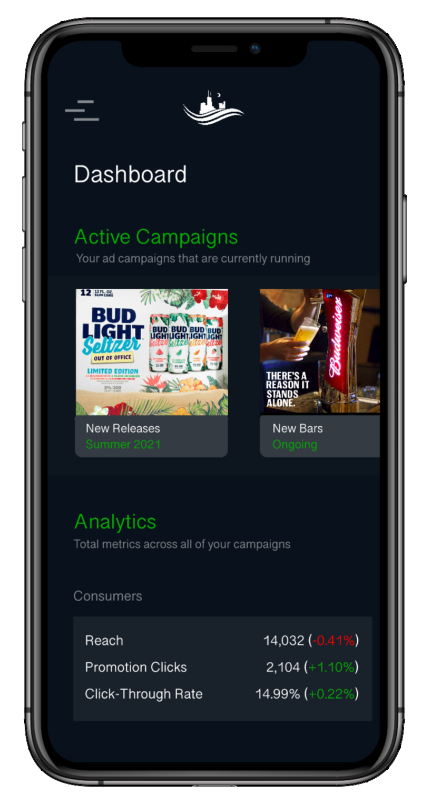
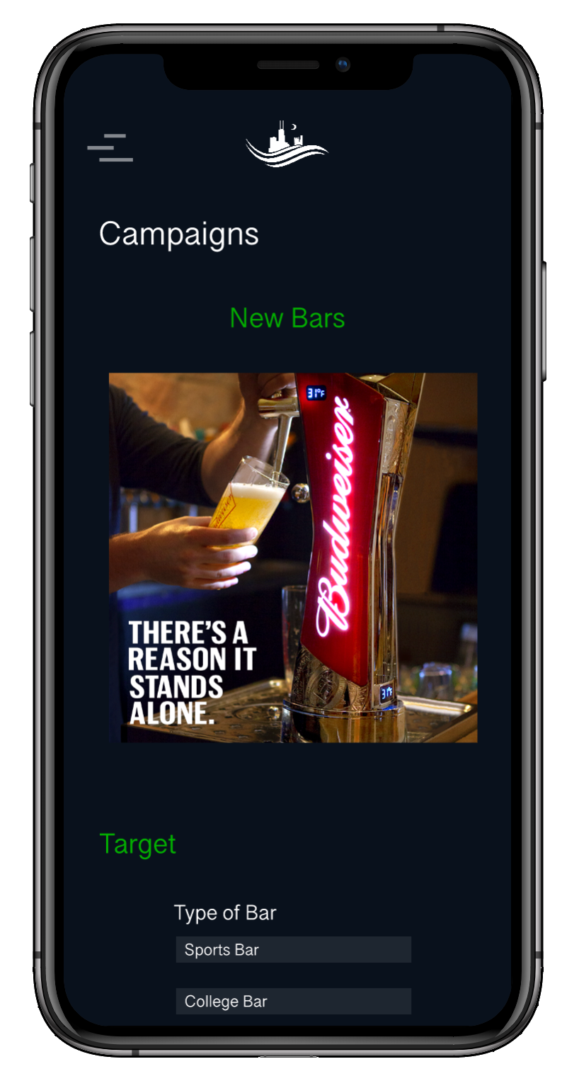
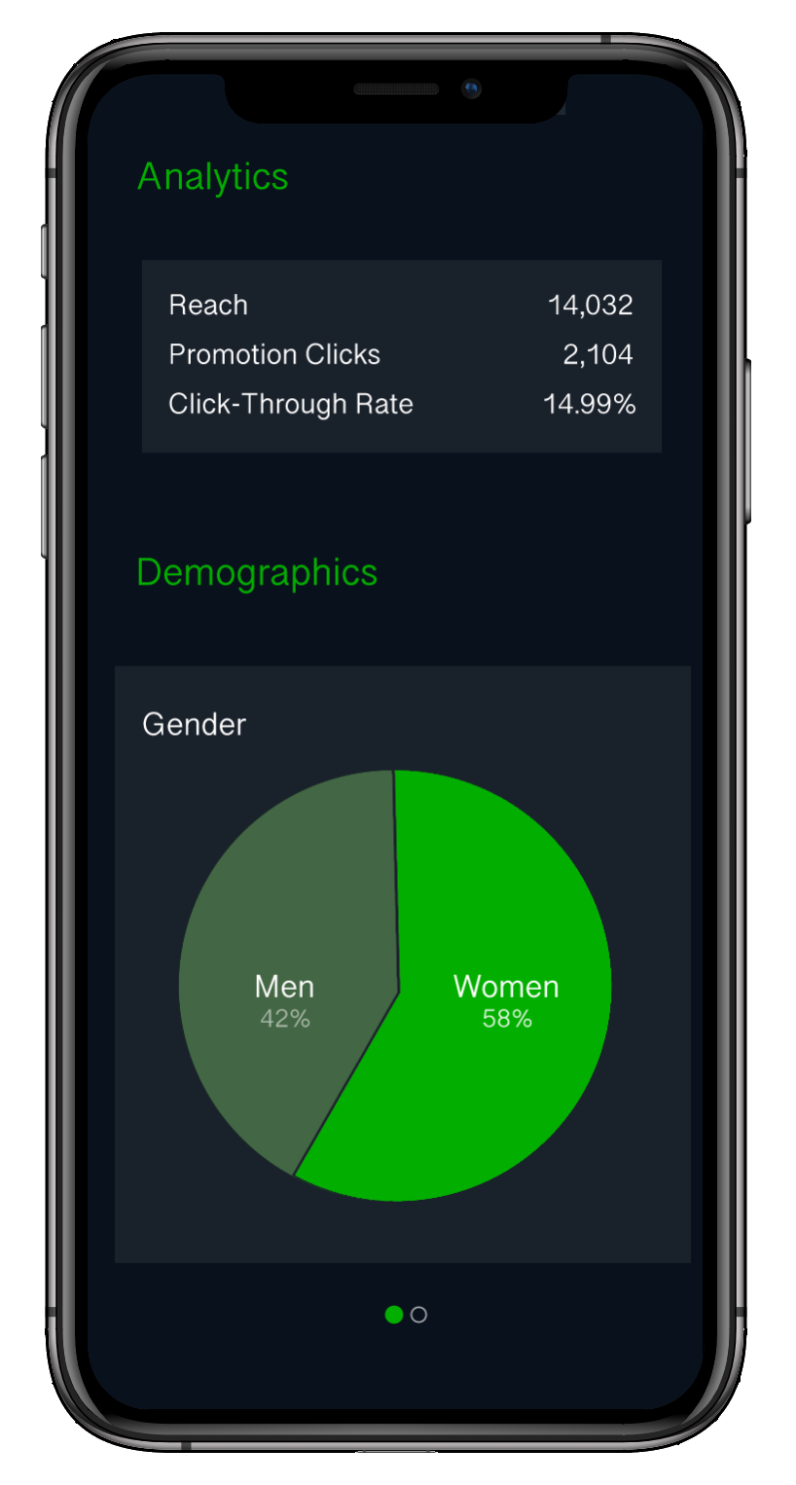
For Liquor & Beer
Companies
Track all of your current marketing activity from a convenient dashboard
Run ad campaigns targeted towards specific segments of bars or bar goers on both WAVE apps.
Compile analytics from your ad performances to continuously improve targeting and conversions.

Slide 9
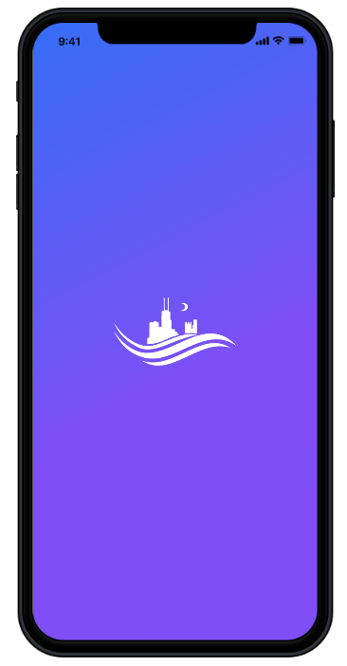
CONSUMERS
BUSINESSES
Bars use the Wave Business app to track their traffic and market their deals and events to consumers. Liquor and beer companies market to both bars and consumers across both apps.
Consumers use the Wave app to find bars to go to and make plans with friends..

Slide 10
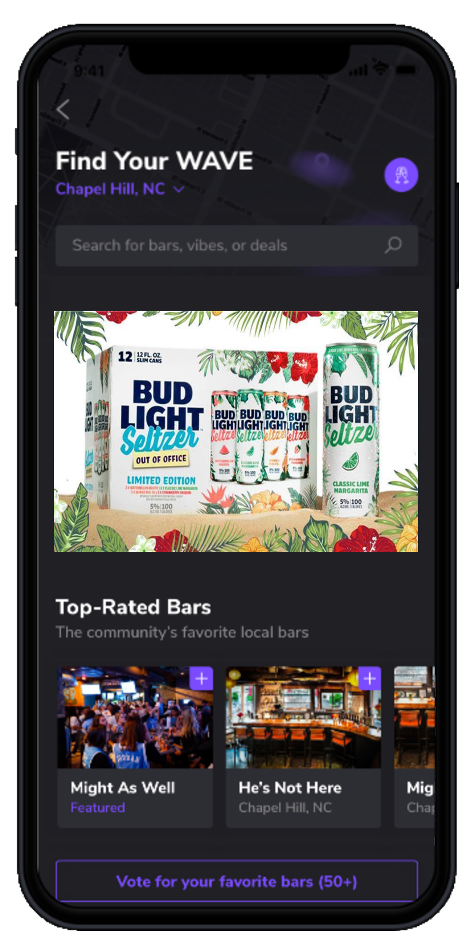
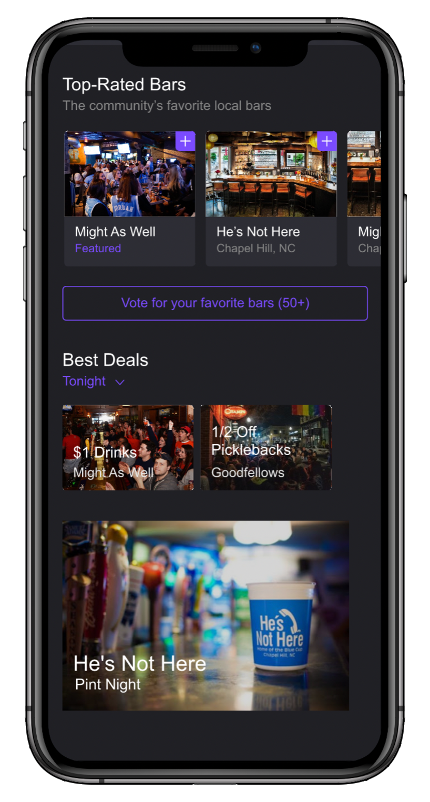
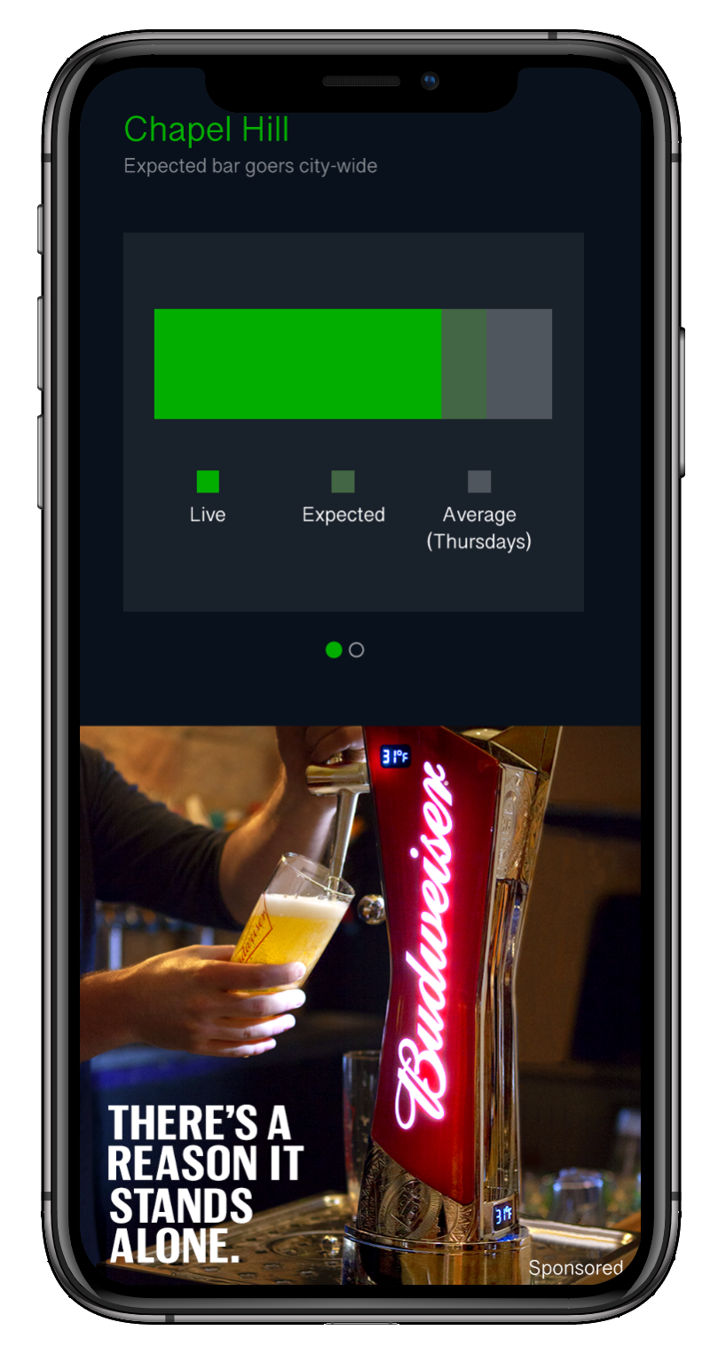
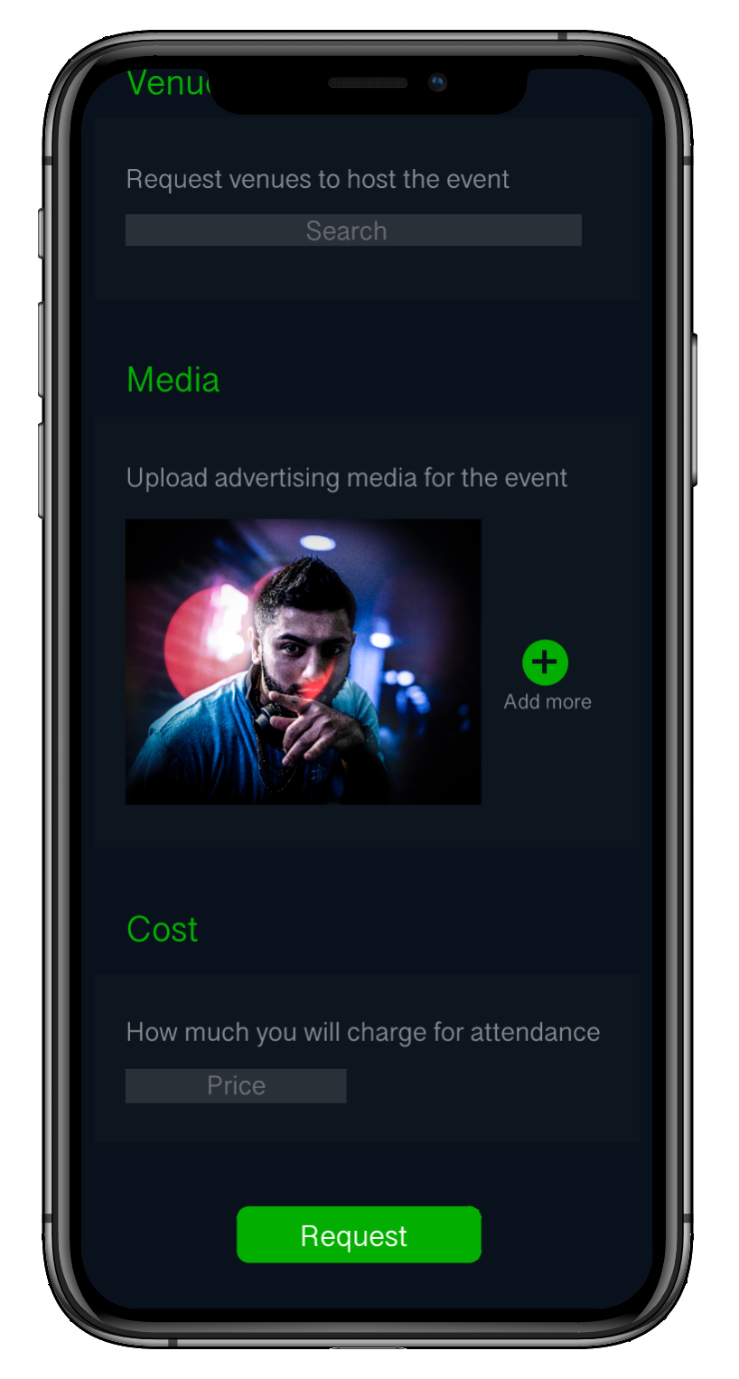
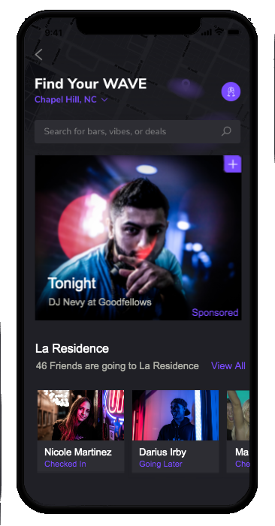
Liquor and beer companies advertise to both bars and bar goers on their respective apps (left).
Ads
Bars advertise events and deals to bar goers (top right). DJs and promoters can book and advertise events to bar goers as well (bottom right).

Slide 11
Thank you
Contact
Willie Barron
CEO & Co-Founder
wbarron@thewavenc.com
https://www.thewavenc.com/

