Slide 1
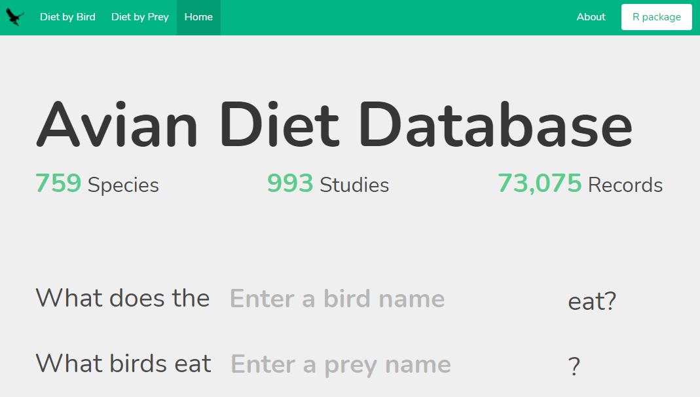
Former COMP 523 students:
Muyan Pan
Teddy Randby
Thomas Le
https://aviandiet.unc.edu

Slide 2
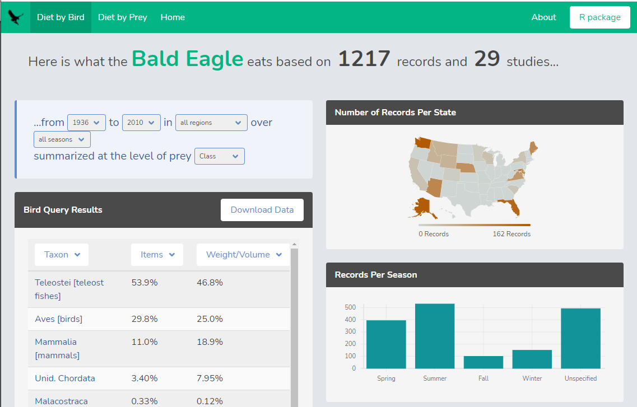

Slide 3
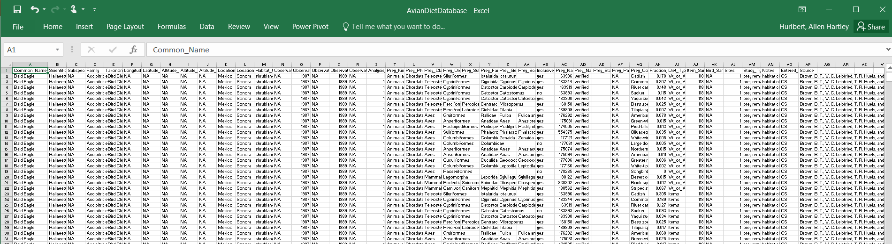
Current workflow:
Find a published paper with quantitative info on what a bird eats.
Enter contextual info (where, when, how, etc.) as well as diet info in large flat file.

Slide 4
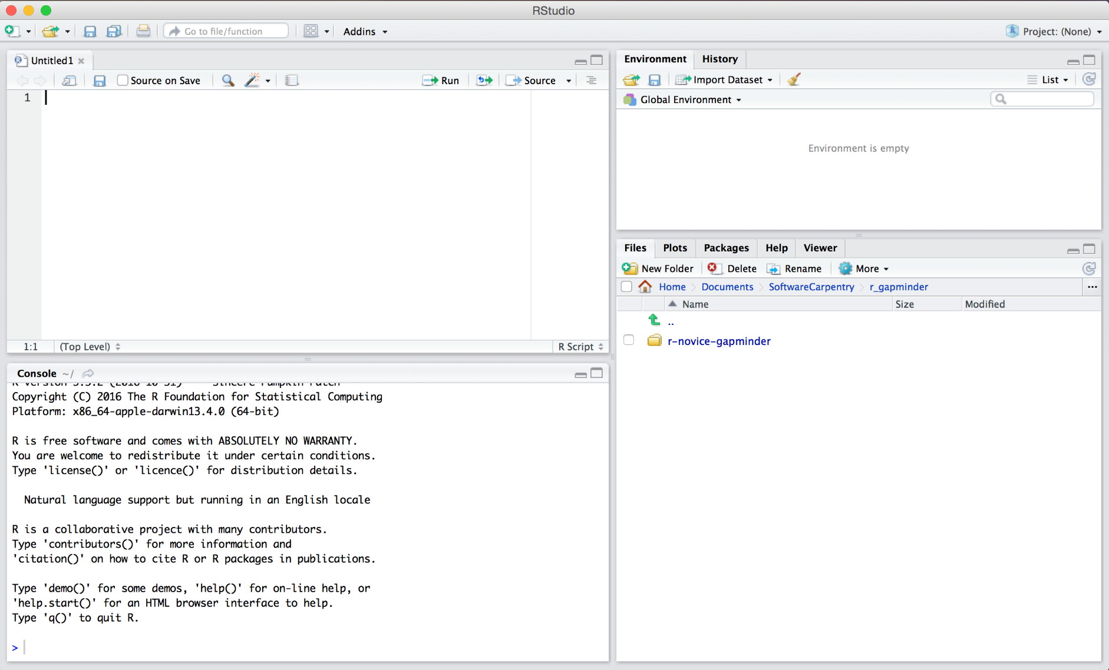
Current workflow:
Find a published paper with quantitative info on what a bird eats.
Enter contextual info (where, when, how, etc.) as well as diet info in large flat file.
Run QA/QC checks on flat file using R scripts, including checking prey taxonomy via API

Slide 5
Current workflow:
Find a published paper with quantitative info on what a bird eats.
Enter contextual info (where, when, how, etc.) as well as diet info in large flat file.
Run QA/QC checks on flat file using R scripts, including checking prey taxonomy via API
Append flat file to Master Database on Github

Slide 6
COMP 523 Project Requirements
Develop a web-based data entry portal. Some of the required features include:
Integrate data entry into existing aviandiet.unc.edu website
login/user accounts (to track who is entering data)
automated QA/QC checks
Interface with taxonomy API
Double data entry
a reviewer dashboard to easily inspect newly entered data
integration of entered and approved data to an existing database on Carolina Cloud Apps
(learn RedHat’s OpenShift Container Platform)

