Slide 1
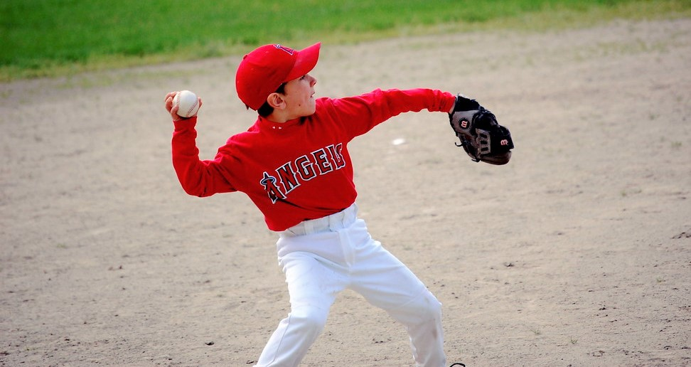
Where’s the throw?
Teaching baseball fundamentals through gamification

Slide 2
15.9 Million
kids played baseball in 2018 up 21% from 2014. -The Wall Street Journal
Football and Soccer are trending downward. Basketball is stagnant. - Sports Fitness & Industry Association

Slide 3
Practice Time is Limited
Physical Skills require a lot of time
Catching
Throwing
Hitting
Fielding
Mental and Strategic Skills are ignored at a great cost come game time

Slide 4
Existing Competitors don’t reach kids of today!
2006 CD Rom
$24.95
Book
$16.95
($2.95 kindle)

Slide 5
Concept of Product
IOS and/or Android platform
Retro game design interface (think Space Invaders or Pac Man)
Player chooses position
Player is given game scenario (e.g. 1 out, runners on 1st and 3rd)
Player is told they have fielded either a fly ball or grounder
Player then touches where they would throw
Points awarded on correct answer and time
Player can compare their scores with everyone else who has played that day, month, year?
Players can group themselves by team or school?

